Slide 1
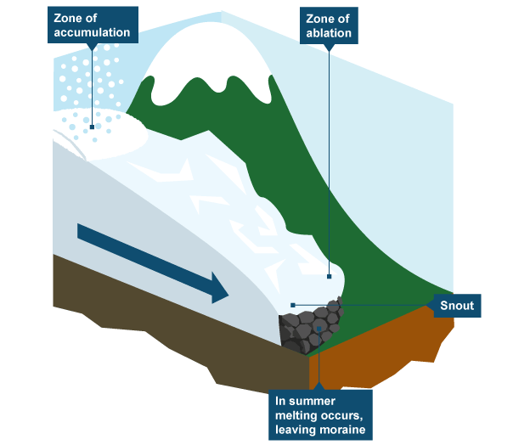
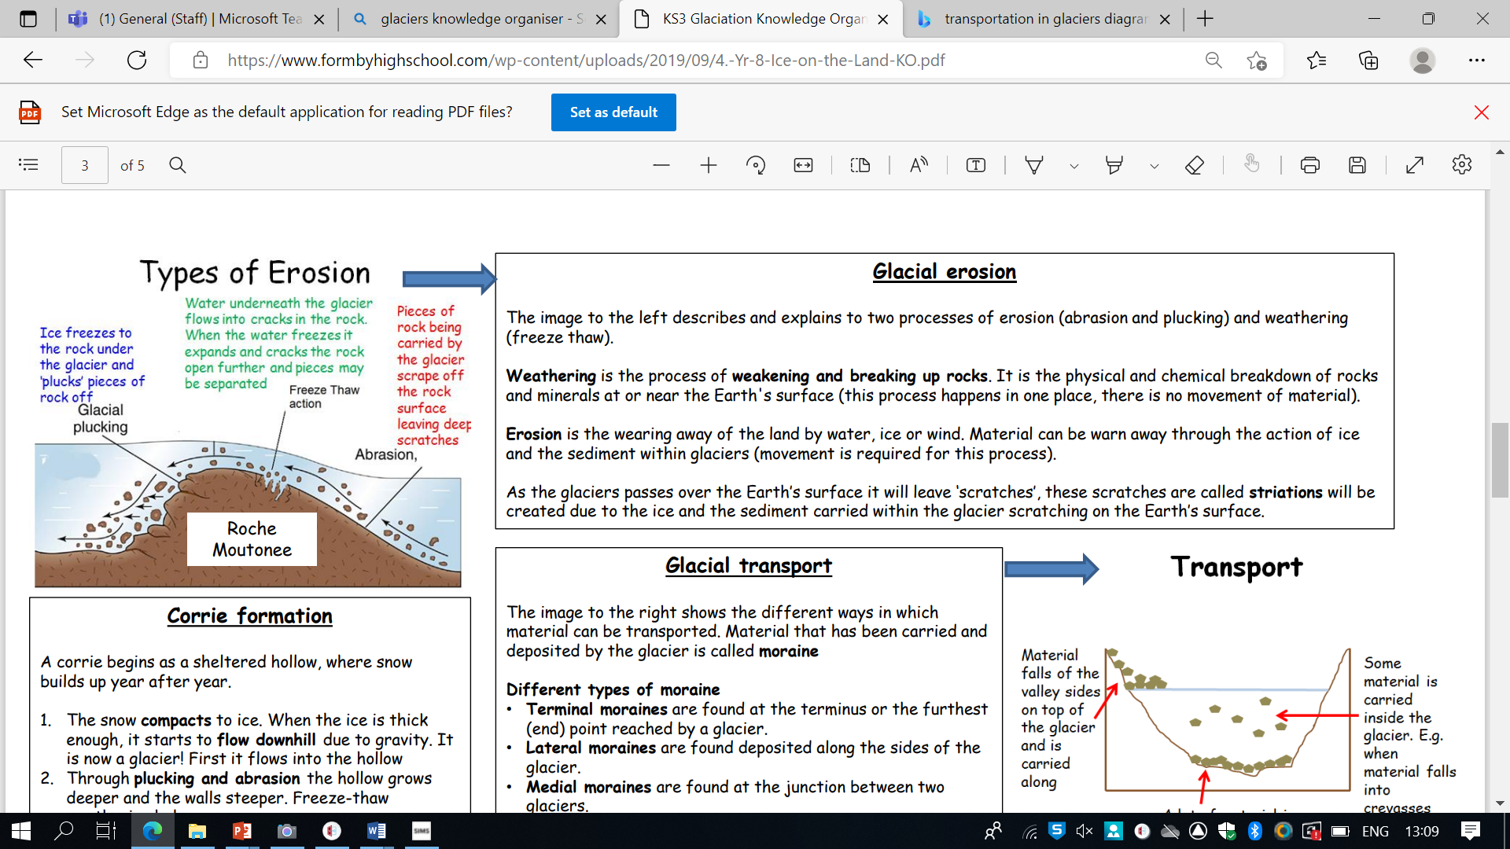
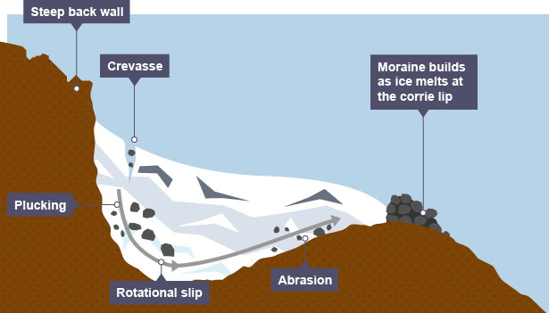
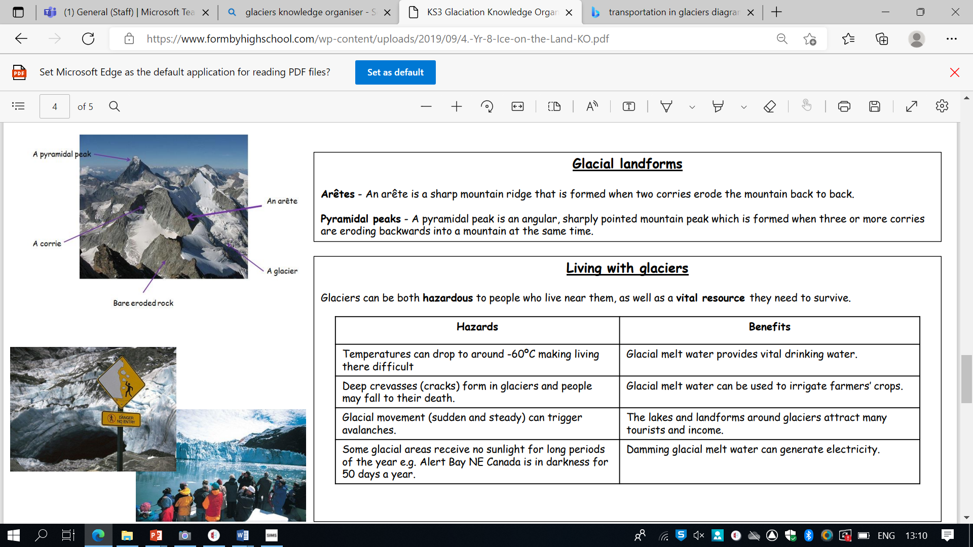
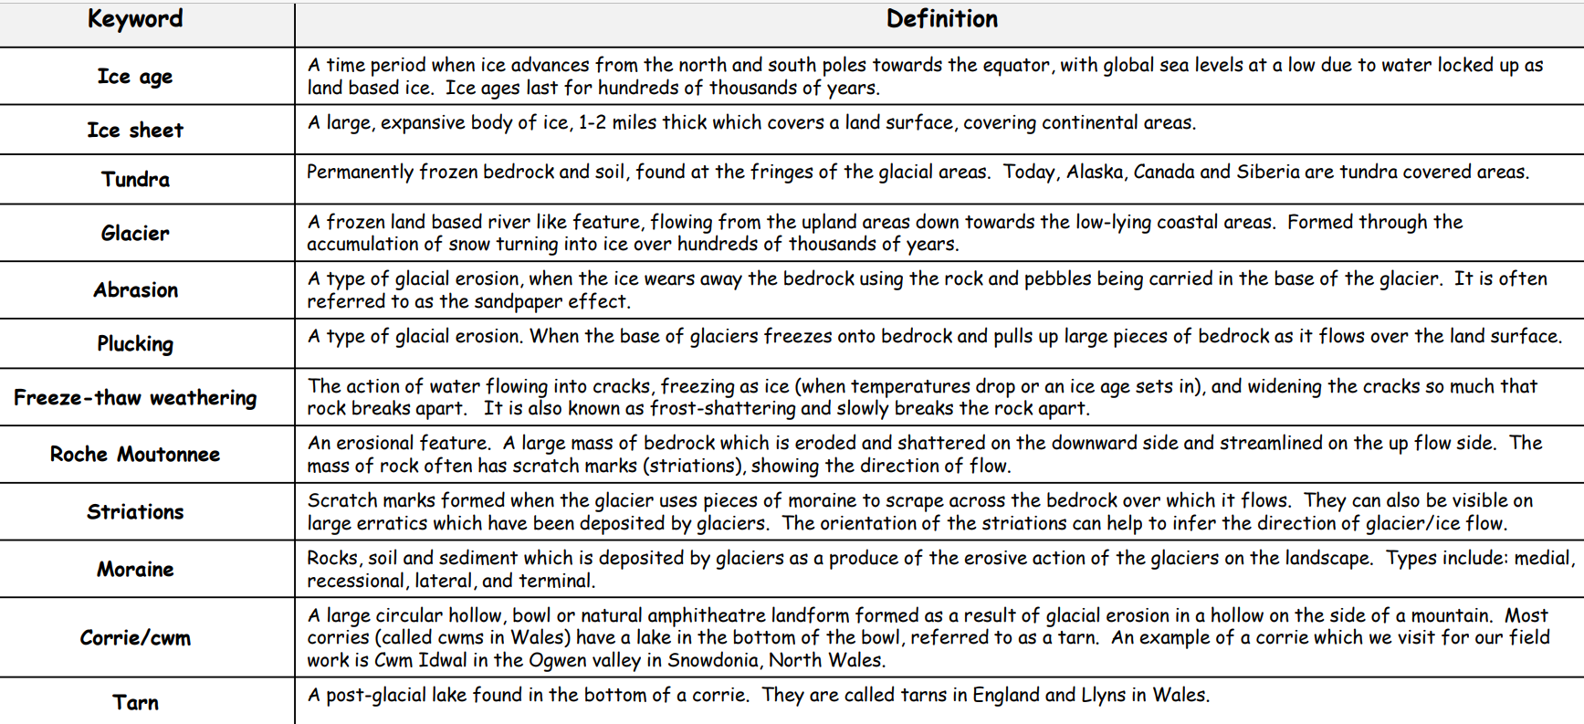
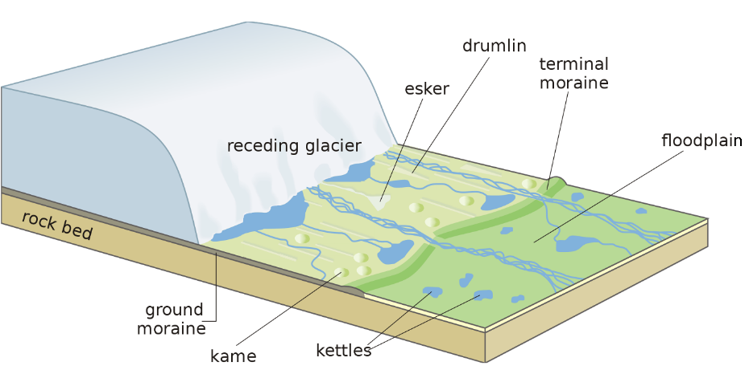
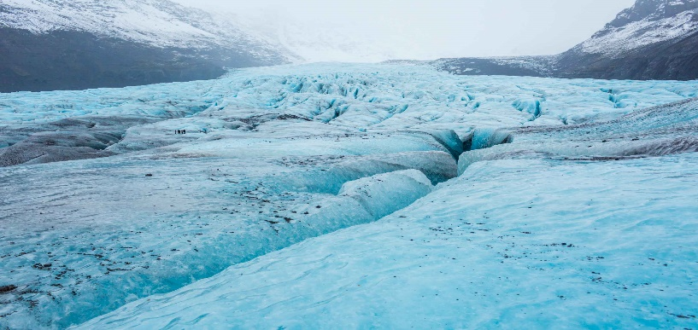
Year 9 Glaciers
Glacial erosion
The image to the left describes and explains to two processes of erosion (abrasion and plucking) and weathering (freeze thaw). Weathering is the process of weakening and breaking up rocks. It is the physical and chemical breakdown of rocks and minerals at or near the Earth's surface (this process happens in one place, there is no movement of material). Erosion is the wearing away of the land by water, ice or wind. Material can be warn away through the action of ice and the sediment within glaciers (movement is required for this process). As the glaciers passes over the Earth’s surface it will leave ‘scratches’, these scratches are called striations will be created due to the ice and the sediment carried within the glacier scratching on the Earth’s surface.
Glacial transport
The image to the right shows the different ways in which material can be transported. Material that has been carried and deposited by the glacier is called moraine Different types of moraine
• Terminal moraines are found at the terminus or the furthest (end) point reached by a glacier.
• Lateral moraines are found deposited along the sides of the glacier.
• Medial moraines are found at the junction between two glaciers.
• Ground moraines are disorganised piles of rocks of various shapes, sizes and of differing rock types
Glacier Landforms

