Slide 1
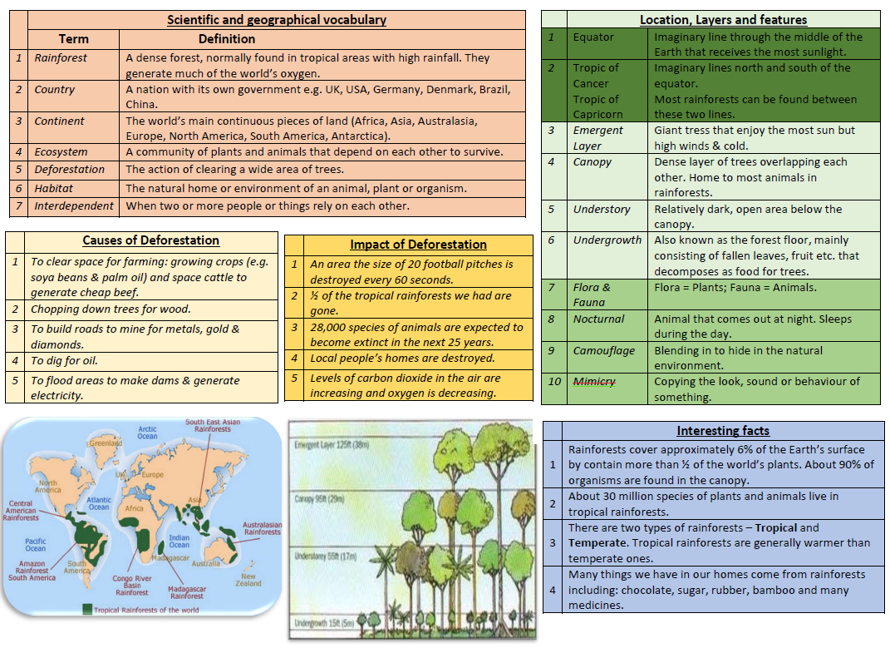
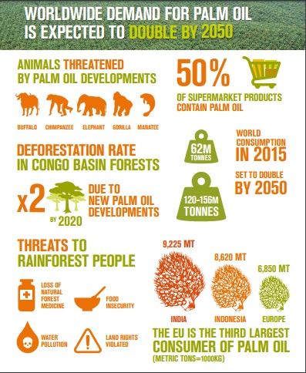

Emergent
Canopy
Understory
Ground/ Undergrowth

