Slide 1
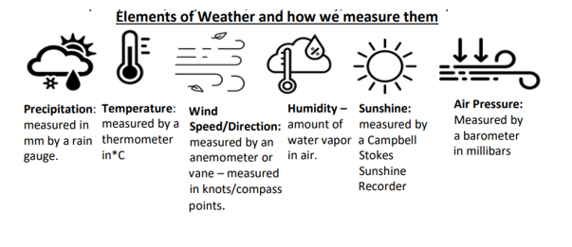
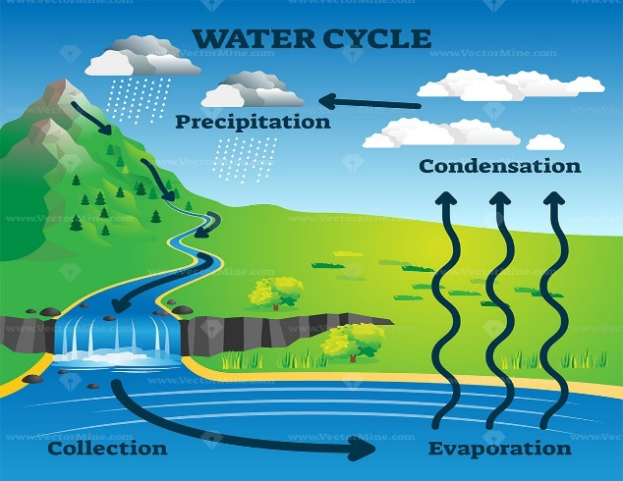
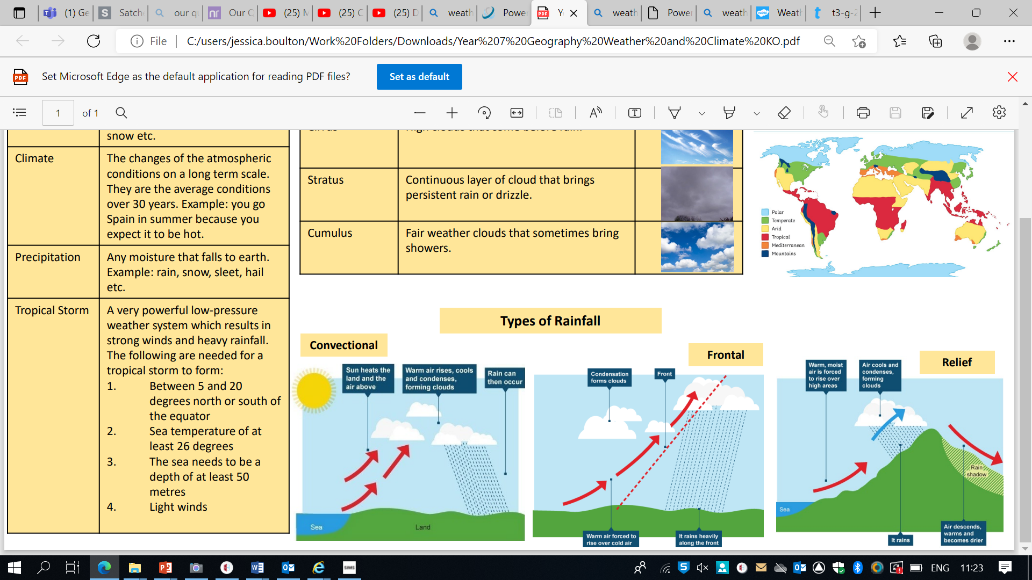
Year 7 Weather and Climate
climate The average weather conditions for a place usually measured over a long period
of time (30 years).
climate graph A graph which shows the typical monthly rainfall and temperatures for a place.
climate zone An area that has its own climate. Climate zones also have their own type of
vegetation and wildlife.
clouds A large collection of very tiny droplets of water or ice crystals which float in the air.
cloud cover The amount of cloud covering the sky. Cloud cover is measured in oktas (eighths).
cold front The leading edge of a cold air mass.
condensation The process when water vapour turns into a liquid.
vapour condenses to form cloud droplets.
convectional rainfall Rain formed when the ground heats up during warm, sunny weather.
dehydration When our bodies don’t have enough water.
depression A low pressure weather system which brings clouds and rain.
drought A prolonged period of little or no rainfall, leading to a shortage of water.
evaporation The process when water turns from a liquid to a gas (water vapour).
flood When land that is usually dry is covered by water.
front The boundary between two air masses.
frontal rainfall Type of rainfall formed when two air masses meet.
heatwave A long period of extremely high temperatures.
high pressure When air pressure is higher than average. High air pressure is caused by sinking air.
latitude How far north or south a place is from the equator.
low pressure When air pressure is lower than average. Low air pressure is caused by rising air
Weather The day to day conditions of the atmosphere such as rain, run and the air temperature

