Slide 1
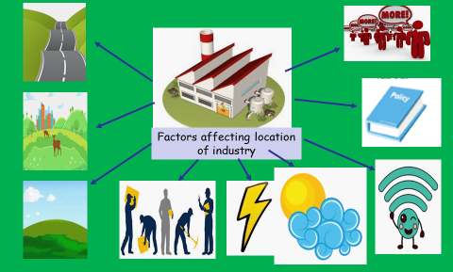
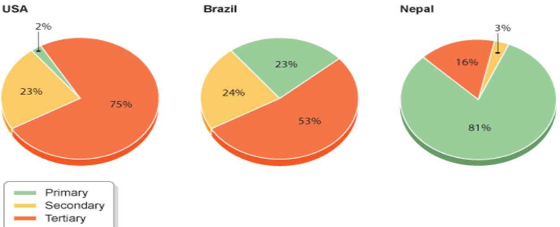
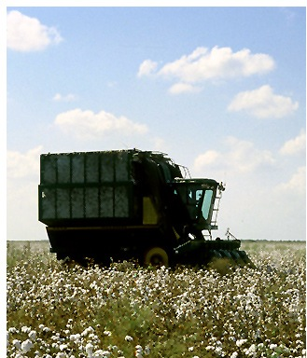
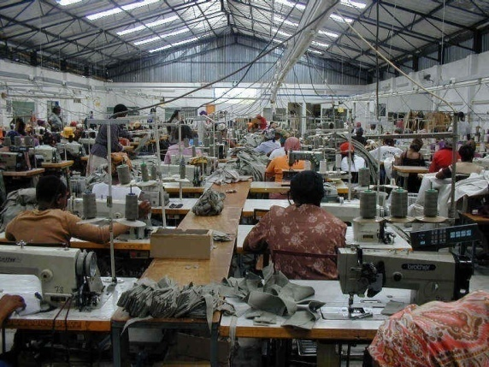


Economic Activity
Primary Industry: The extraction and provision of raw materials from the earth – eg. farmer.
Secondary Industry: This is the making or manufacturing of products: eg. car assembly worker.
Tertiary Industry: The provision of a service – eg. teacher, shop assistant.
Quaternary Industry: This is research and development of products and services– eg. scientific researcher.
HIC
NEE
LIC
-As countries develop they move away from primary industry and towards secondary industry
-The UK was once built on primary industries such as coal mining and farming
-The UK now has most people employed in the tertiary sector.
-Most of the primary employment in the UK is farming. Depending on location and environment this could be: arable, hill, pastoral or crofting.
What goes into the system.
Things you do to the inputs.
Finished product.
Researching new/improved inputs and processes.
As a country develops it gains more skills and education meaning that the workforce becomes “highly skilled” and expensive. This means that many factories are moved from HIC to LIC as there is a larger and cheaper workforce.
INPUT
PROCESS
OUTPUT
FEEDBACK

