Slide 1
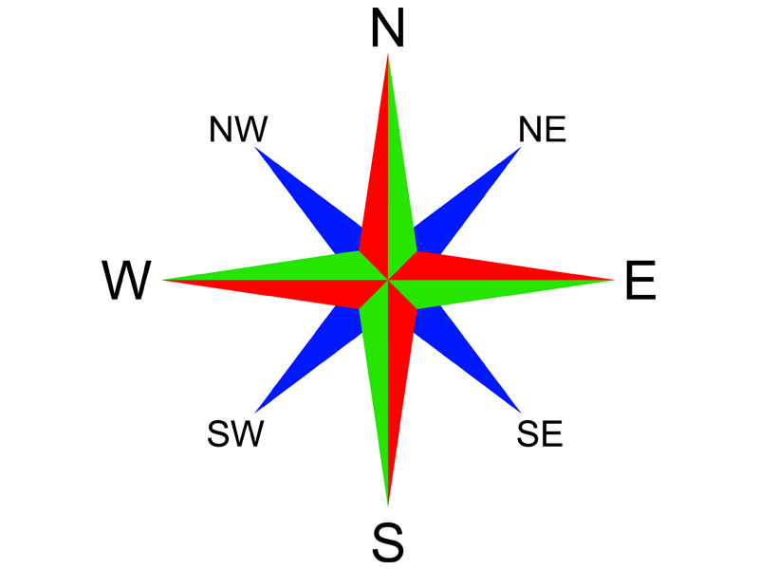
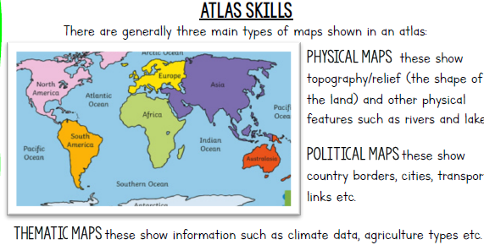
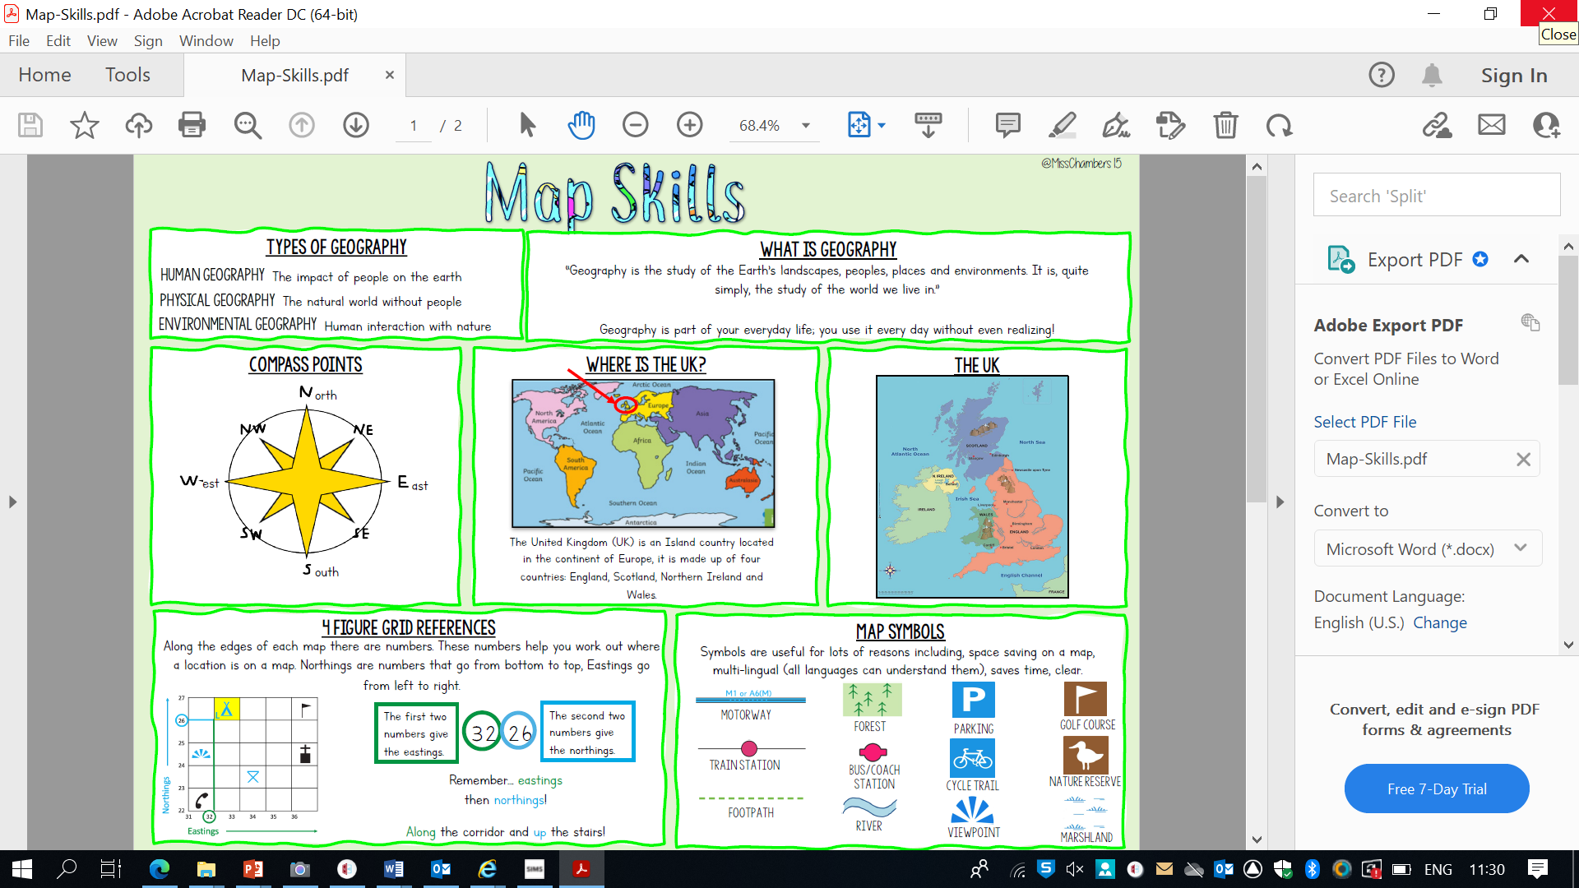

Year 7 Map Skills Knowledge Organiser
The basics of mapping
Maps are representations of the world created by people called cartographers to help other people navigate the world. Maps contain information tailored to a specific purpose.
A road map, for example, contains information that helps the reader get from one place to another using a vehicle.
The maps found in a geographical atlas will contain information of less interest to a road user, such as how the land in a place is used, the population density and the political boundaries that exist between regions, states and nations.
There are five fundamental things you need to be familiar with to read a map successfully:
compass directions
grid references
map's key
title
scale

