Slide 1
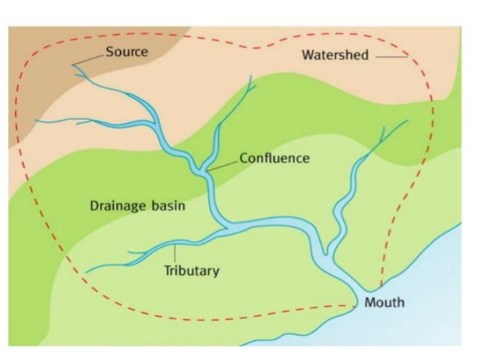
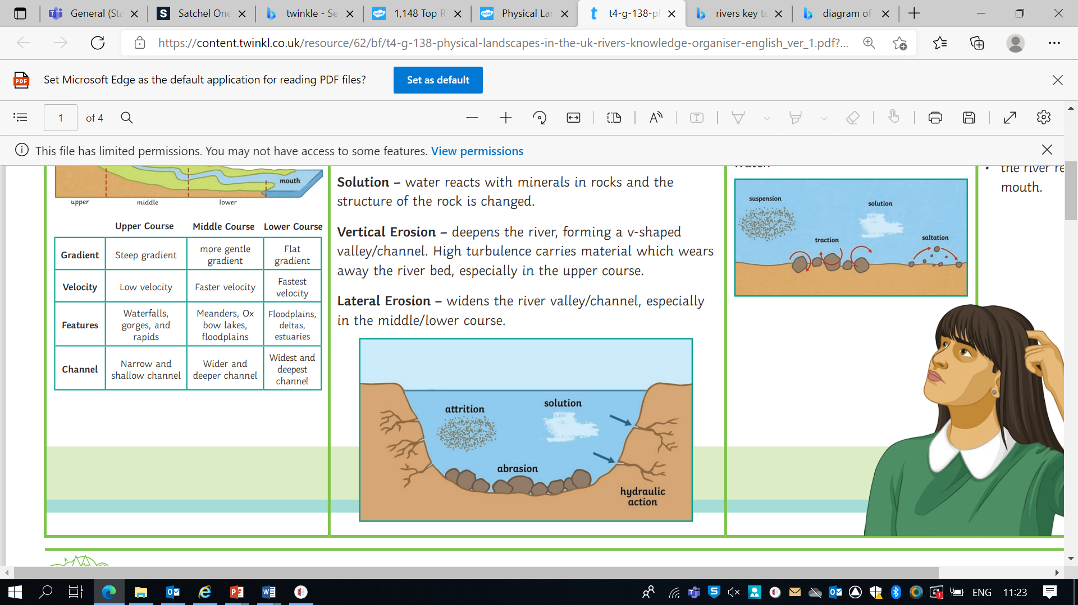
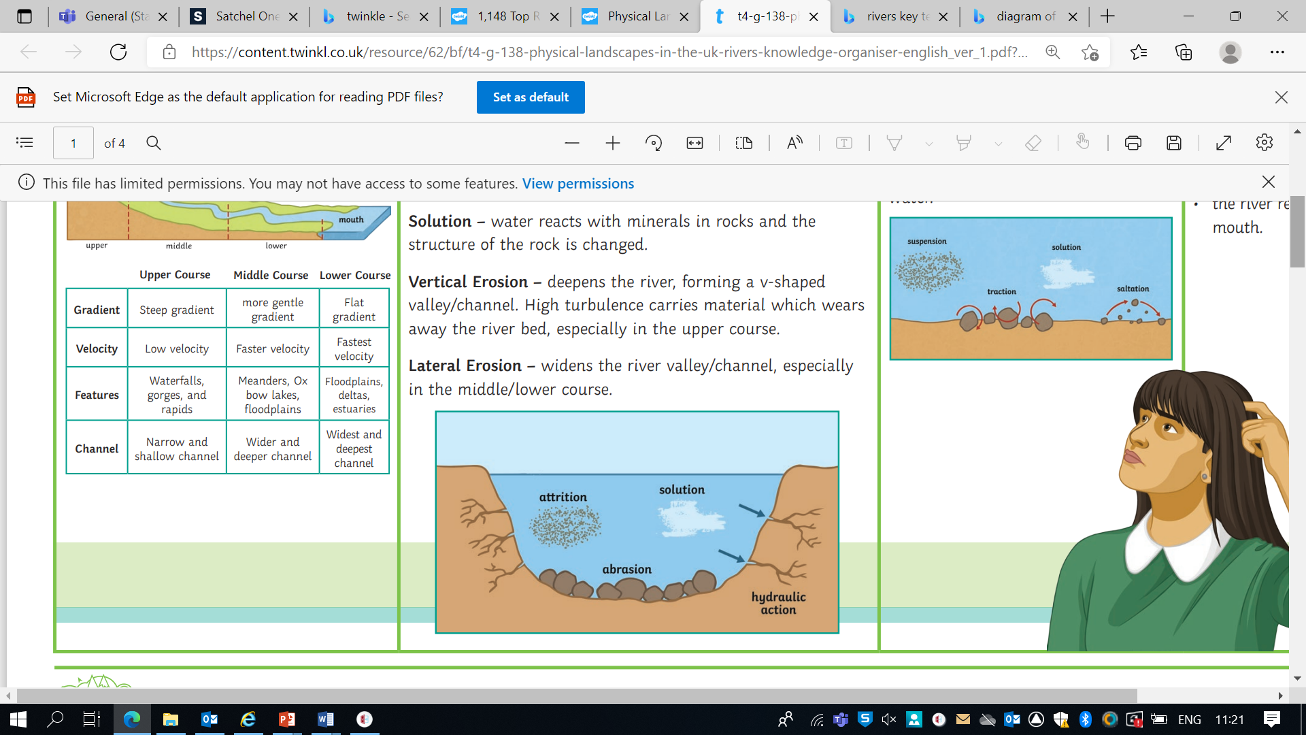
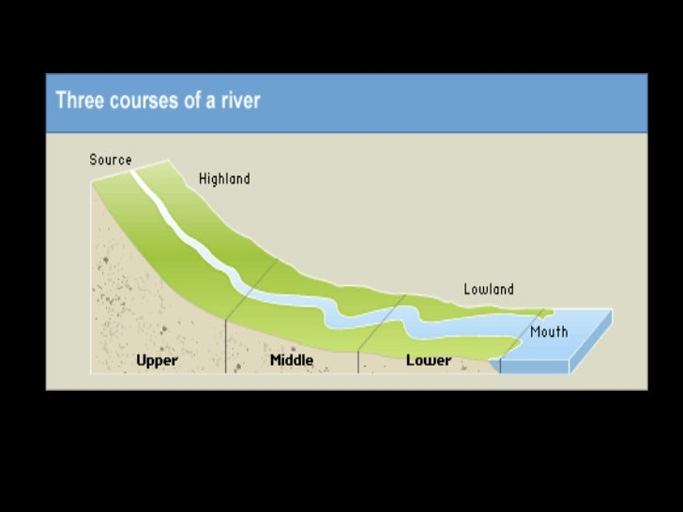
Key Terms
Drainage basin - the area of land drained by a river
Catchment area - the area within the drainage basin
Watershed - the edge of highland surrounding a drainage basin and it marks the boundary between two drainage basins
Source - the beginning or start of a river
Confluence - the point at which two rivers or streams join
Tributary - a stream or smaller river which joins a larger stream or river
Mouth - the point where the river comes to the end, usually when entering a sea
Hydraulic action - This is the sheer power of the water as it smashes against the river banks. Air becomes trapped in the cracks of the river bank and pieces of rock break away.
Abrasion - When pebbles grind along the river bank and bed in a sand-papering effect.
Attrition - When rocks that the river is carrying knock against each other. They break apart to become smaller and more rounded.
Traction - large, heavy pebbles are rolled along the river bed. This is most common near the source of a river, as here the load is larger.
Saltation - pebbles are bounced along the river bed, most commonly near the source.
Suspension - lighter sediment is suspended (carried) within the water, most commonly near the mouth of the river.
Solution - the transport of dissolved chemicals. This varies along the river depending on the presence of soluble rocks.
River Landscapes Year 8 Knowledge Organiser
Drainage Basin Diagram
Erosion
Transportation
Waterfalls
Waterfalls often form in the upper stages of a river where it flows over different bands of rock. It erodes soft rock more quickly than hard rock and this may lead to the creation of a waterfall.
Formation of a waterfall:
The soft rock erodes more quickly, undercutting the hard rock.
The hard rock is left overhanging and because it isn’t supported, it eventually collapses.
The fallen rocks crash into the plunge pool. They swirl around, causing more erosion.
Over time, this process is repeated and the waterfall moves upstream.
A steep-sided gorge is formed as the waterfall retreats.
A meander is a bend in the river and are formed by erosion and deposition. As the river flows around a meander, centrifugal forces cause the water to flow fastest around the outside of the bend. This creates erosion on the outside and deposition on the inside of the bend, which means that the meander slowly moves

