Slide 1
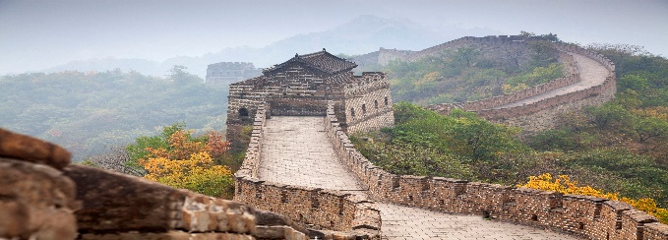
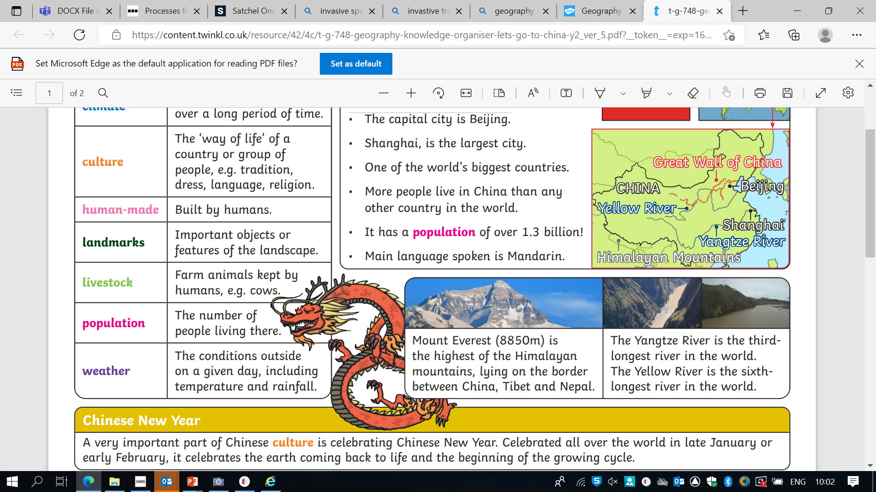
What are the physical characteristics of China?
The People’s Republic of China is the fourth largest country in the world by area. It covers an area of 9,596,960 km², which is approximately 39 times greater the size of the UK. The country spans five .
China is located in the . Around a third of the country is mountainous, which includes Mount Everest in the Tibetan Autonomous Region of China. The of China also consists of Asia’s largest rivers such as The Yangtze and The Yellow Rivers and forests. China also has a very long coastline.
Chinas One Child Policy
In the late 1970s, the Chinese government introduced a number of measures to reduce the country's birth rate and slow the population growth rate. The most important of the new measures was a one-child policy, which decreed that couples in China could only have one child.
Impact of the policy
The birth rate in China has fallen since 1979, and the rate of population growth is now 0.7%.
There have been negative impacts too - due to a traditional preference for boys, large numbers of female babies have ended up homeless or in orphanages, and in some cases killed. In 2000, it was reported that 90% of foetuses aborted in China were female.
As a result, the gender balance of the Chinese population has become distorted. Today it is thought that men outnumber women by more than 60 million.
What are the human characteristics of China?
Life expectancy and literacy rates
China is the most country in the world, with approximately 1.4 billion people. Around 18 per cent of the world’s total population live in China. is almost 77 years. are above 97 per cent, meaning most Chinese people can read and write.
Population distribution
Most people live in the eastern half of the country. This is where the , Beijing, and many other larger cities are located. Around 60 per cent of China’s population live in cities. The east of China is coastal, with many large . Fewer people live in the mountainous and regions to the north and west.
Agriculture Farming.
Climate What the weather is like
over a long period of time.
Culture
The ‘way of life’ of a
country or group of
people, e.g. tradition,
dress, language, religion.
Human-made Built by humans.
landmarks Important objects or
features of the landscape.
Livestock Farm animals kept by
humans, e.g. cows.
Population The number of
people living there.
Weather
Weather and Climate –
The weather and temperatures are very different across the country. The climate varies from warm tropical weather (in the south) to subarctic (as low as -30°C in the north). In summer, most areas are hot and rainy. There are dry seasons and wet monsoons (a seasonal wind that brings heavy rainfall). In winter, most areas are cold and dry.
Known as the People’s Republic of China.
• Located in east Asia.
• The capital city is Beijing.
• Shanghai, is the largest city.
• One of the world’s biggest countries.
• More people live in China than any other country in the world.
• It has a population of over 1.3 billion!
• Main language spoken is Mandarin second is Cantonese

Slide 2
