Slide 1
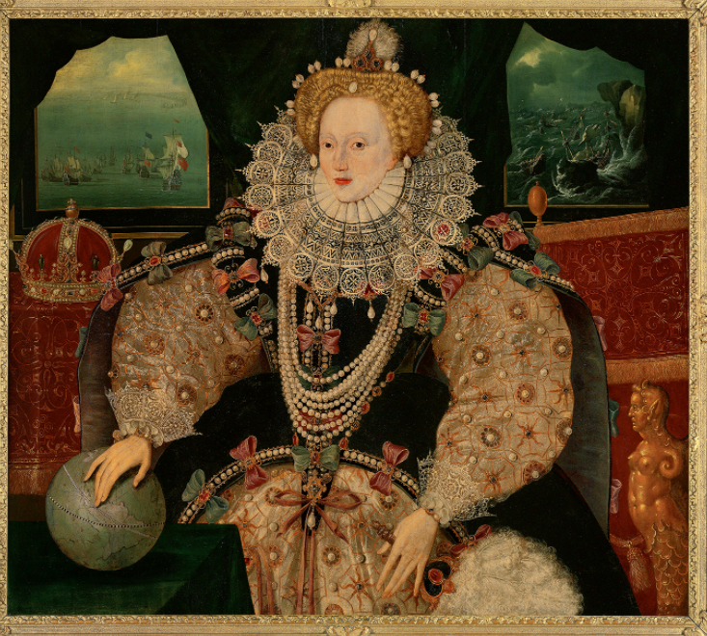
How successful was Elizabeth I as Queen of England and Wales?
Important words | Important words
1 | Pope | The head of the Catholic Church
2 | Clergy | People who have jobs in the Church
3 | Heretic | Someone considered to be following a false religion
4 | Recusant | Someone who refused to attend Anglican church under Elizabeth’s rule
5 | Armada | A fleet of battleships
6 | Suitor | A man pursuing a relationship with a woman, aiming for a marriage
7 | Treason | A crime, to try and overthrow the leader of one’s country
8 | Monarch | A sovereign head of state – typically a King/Queen
9 | Rebellion | Organised resistance to a leader or a government – typically armed
10 | Propaganda | Information which is biased and intended to persuade an audience of an idea or point of view
Important people | Important people
1 | Queen Elizabeth I | Elizabeth inherited many problems from previous Tudor monarchs and needed to make compromises in England to establish a religious settlement. She also had to deal with threats from abroad.
2 | King Philip II of Spain | A powerful Spanish ruler who had desires to take control of England and expand his empire.
Important ideas/information | Important ideas/information
1 | Roman Catholic | A follower of Roman Catholicism, which is now a group within a wider Christian Church. It was the only religion recognised in medieval Europe and specifically in Western Europe; Roman Catholics accept the Pope as their leader on Earth.
2 | Protestant | A protest movement that opposed papal authority and sought to bring the translated bible to the masses in order to reduce the power held by the Catholic Church.
3 | English Reformation | Starting with Henry VIII’s break-away from Rome, this change in religious policy was amended by Elizabeth in order to establish her as the head of a protestant ‘Church of England.’
4 | Golden Age | A time in history where there is security, peace and growth in the economy and the arts
5 | English Renaissance | A cultural and artistic movement, wherein literature and music saw change and growth
Timeline |  |  | Timeline
1559 Elizabeth crowned Queen of England | 1585-1604 Elizabethan war with Spain – Disputes over wealth and colonization of the Americas | 1586 Babington's plot to kill Elizabeth discovered and stopped | 1587 Execution of Mary, Queen of Scots due to her confirmed involvement in the Babington Plot | 1588 Spanish Armada is defeated by English fleets under command of Sir Francis Drake and Sir John Hawkins

