Slide 1
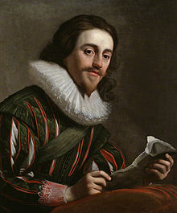
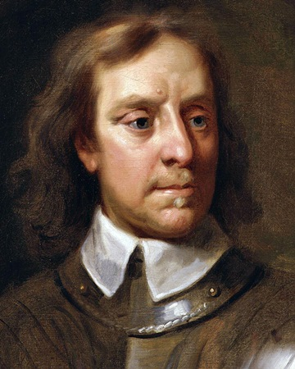
What were the causes for the English Civil War (1642-1651)
Important words | Important words
1 | Parliament | Governing body of the United Kingdom: sets laws and discusses public affairs
2 | Absolutism | The holding of strong principles with no negotiation
3 | Act of Attainder | A declaration of someone's guilt without trial – sometimes used by medieval Monarchs and Parliament
4 | Petition of Right | A petition to King Charles from Parliament which protested his use of taxes without parliament’s consent
5 | Meritocracy | A system where those who are capable are promoted to more important roles
6 | Nepotism | A system where those who are connected to powerful people are promoted to more important roles
7 | The Grand Remonstrance | A list of complaints presented to King Charles I of England by the English Parliament and published for all to see
Important people | Important people
1 | James I / VI of England | Cousin and successor to Elizabeth I, believed in the Divine Right of Kings and had disputes with Parliament.
2 | Charles I | Son of James I/ VI and similar in his inability to work with Parliament.
 | Oliver Cromwell | Parliamentary commander during English Civil War and later became ‘Lord Protector’ of England, Scotland and Ireland
Important ideas/information | Important ideas/information
1 | Divine Right of Kings | The belief that kings derived their authority from God and could not therefore be held accountable for their actions by any earthly authority such as a parliament.
2 | Roundheads | Supporters of Parliament during the English Civil War – their goal was to ensure Parliament had supreme authority over the Kingdom.
3 | Cavaliers | Supporters of Charles and the royal rule of the Kingdom during the English Civil War. Notable for their colourful uniforms and support from the wealthy noble class.
4 | New Model Army | The Parliamentary army – Soldiers received military training and were very well-disciplined. Soldiers were promoted when they showed themselves to be good soldiers.
5 | Personal Rule | An 11 year period where Charles I closed parliament and ruled by himself.
Timeline |  |  | Timeline
1625 Charles I marries Henrietta Maria, a Catholic | 1628 Parliament uses the ‘Petition of Right’ to protest Charles illegal taxes | 1634 Charles imposes ‘ship money’, a tax used for coastal defense on the inland population of England | 1641 Parliament publish the ‘Grand Remonstrance’ criticising Charles leadership and response to rebels | Jan 1642 Charles tries to arrest 5 MPs who fled, and the country continues to become divided in their loyalty | August 1642 Charles raises his flag in Nottingham and formally declares war on Parliament

