Slide 1
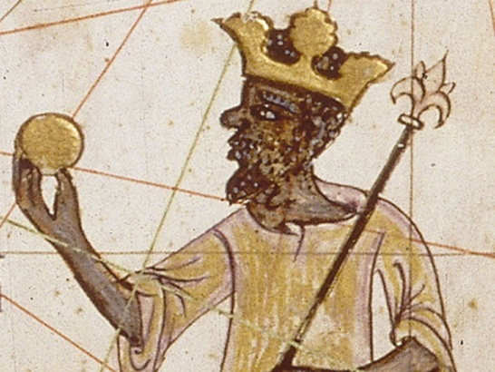
Was Mansa Musa the ‘greatest Mansa’?
Important words | Important words
1 | Mansa | A word meaning "king of kings" or "emperor". It is particularly associated with the Mali Empire
2 | Oba | A ruler of any of several African peoples of western Nigeria, responsible for preserving cultural traditions.
3 | Benin | The Kingdom of Benin was a kingdom in what is now in southwestern Nigeria.
4 | Slavery | A condition in which one human being was owned by another.
5 | Mali | A powerful trading empire that flourished in western Africa from the 13th to the 16th century.
6 | Hajj | Muslim pilgrimage to Mecca, which all Muslims are expected to make at least once during their lifetime
7 | Indigenous | Something which comes from a place natively. E.g. Indigenous religion
Important people | Important people
1 | Musa I | Often called the wealthiest person in history, Musa was the ninth King of the Mali – one of the most powerful West African states
2 | Oba Ewuare the Great | Leader of the Benin people in the 15th century – developed their kingdom and finished constructing the Benin Walls
Important ideas/information | Important ideas/information
1 | Civilization | The process by which a society or place reaches an advanced stage of social and cultural development and organization.
2 | Colonization | the action or process of settling among and establishing control over the indigenous people of an area.
3 | Benin Bronzes | The Benin Bronzes are a group of thousands of objects that were taken by the British from the kingdom of Benin, in what is now Nigeria, in 1897.
4 | The Silk Road | The Silk Road was an ancient trade route that linked the Western world with the Middle East and Asia, with links to North Africa.
5 | Benin Wall | One of Africa's ancient architectural marvels, were destroyed by the British in 1897.
Timeline |  |  | Timeline
1100 City of Timbuktu founded by nomadic tribes | 1324 Mansa Musa I sets off on his Hajj to Mecca, building mosques along the way | 1327 Completion of Djinguereber Mosque in Timbuktu, a cultural landmark for the Mali | 1375 Completion of Catalan Atlas which documented Mali trade routes and the wealth of Musa I | 1442 First Eurpean sailors make contact with West Africa | 1897 The British ransack Benin city and claim the Benin Bronzes which are taken to England and displayed in museums

