Slide 1
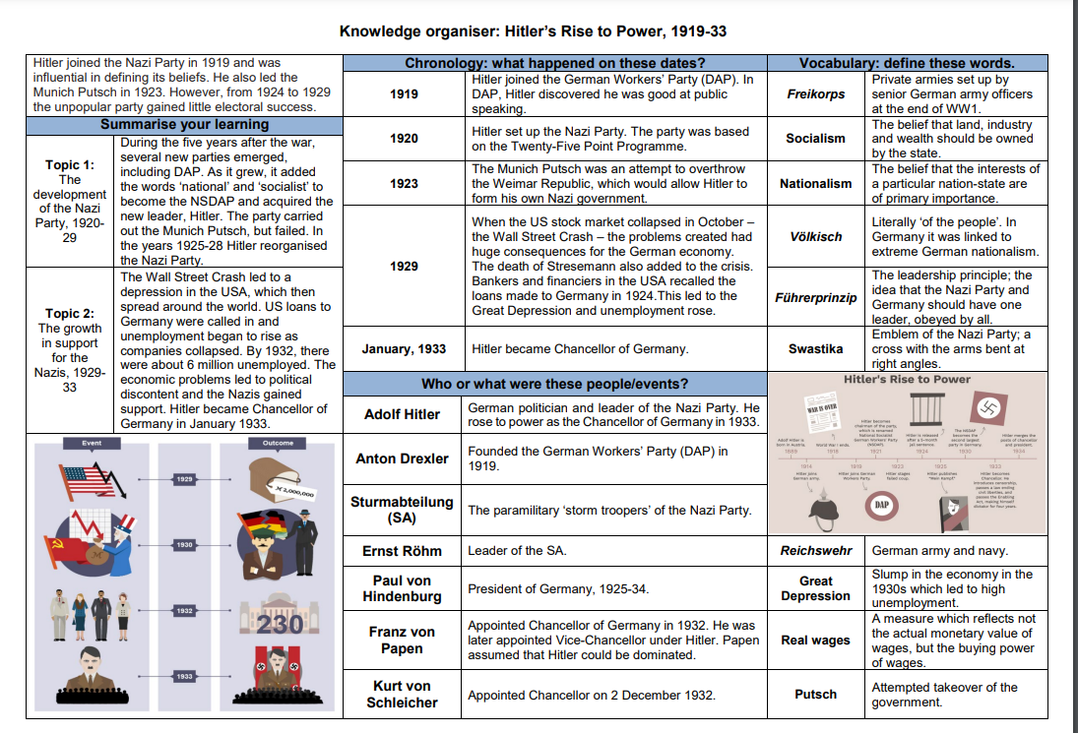

Term 4-
Hitler’s Rise to Power

