Slide 1

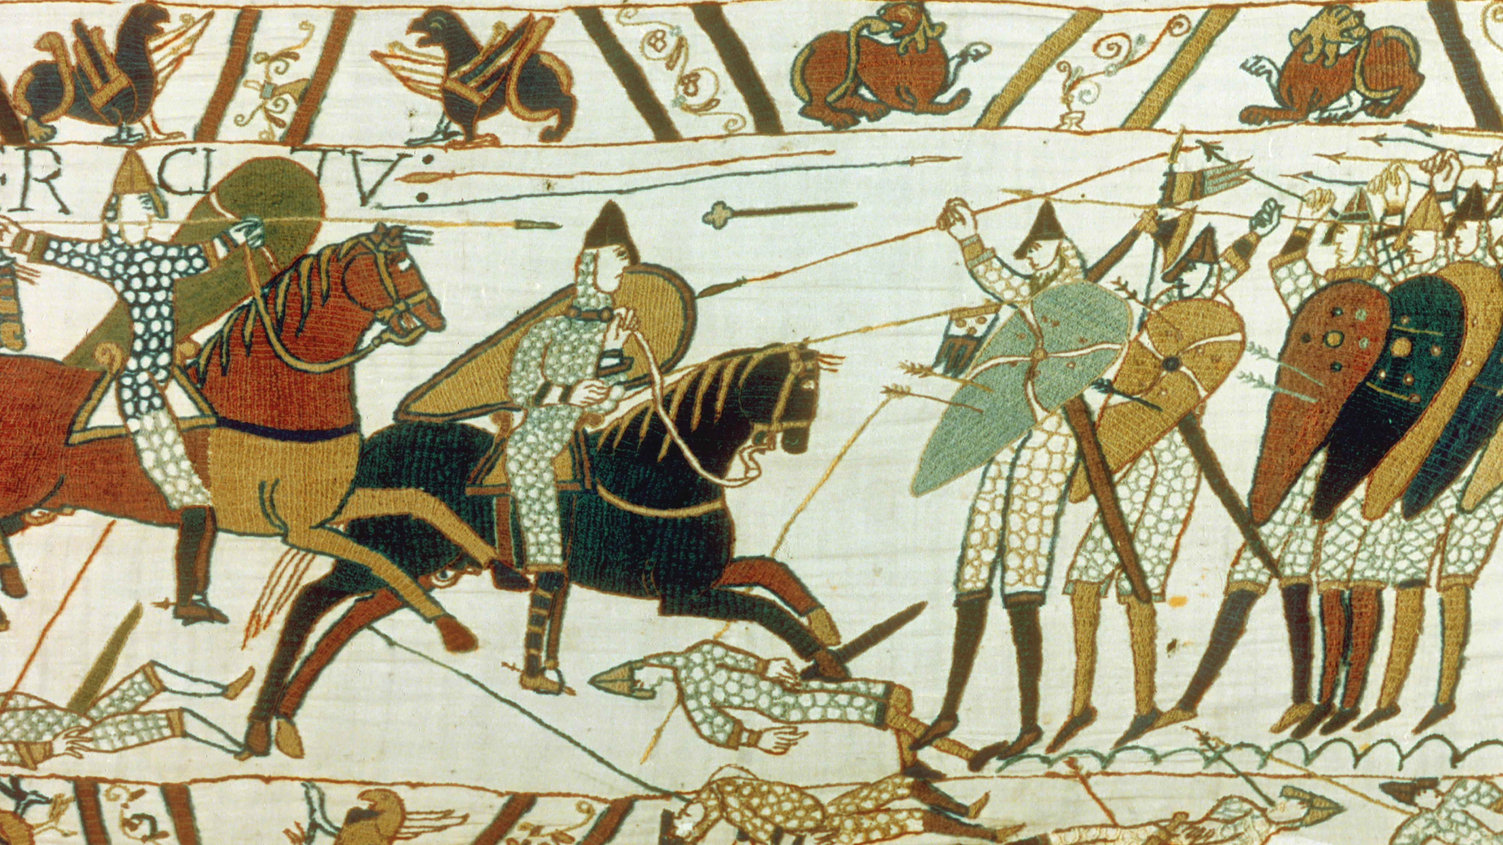
The Norman Conquest, 1066
Important words
Kingship | The ‘art’ of being a king
Succession | Process of inheriting a title e.g. King
Heir | Person who is legally entitled to the rank/property of another after their death
Claimant | Person who asks for something that they believe belongs to them
Legitimate | Have the right to something
Military | Relating to soldiers, weapons or war
Monarch | King or queen
Normandy | Area of modern-day northern France
Warrior | Fierce soldier
Coronation | The ceremony in which a monarch is crowned
Important people
Harold Godwinson | Earl of Wessex
Harald Hardrada | King of Norway
William of Normandy | Duke of Normandy
Tostig | Harold’s brother, killed at the Battle of Stamford Bridge
Edward the Confessor | King of England, 1042-1066
Important ideas/information
Harold Godwinson | Harold claimed that Edward had promised he could be king when Edward died. His sister, Edith, was married to Edward. Harold was also the most powerful English earl. He was a brave and respected soldier. The Witan also wanted Harold to be king.
Harald Hardrada | Harald was the most feared warrior in Europe and used the fact that Viking kings had ruled both Norway and England between 1016 and 1042 as a reason why he should be king. He was supported by Harold Godwinson’s brother, Tostig.
William of Normandy | William was a distant relation of Edward through his mother. William had helped Edward on his return to England to become king in 1042 and had said that Edward had promised him the throne (when he died) as a ‘thank you’. William was an experienced soldier and leader.
Witan | A group of very important people in England. They worked closely with the King and helped him make decisions
 | Timeline
January 5th, 1066 Edward the Confessor, dies. There is a ‘succession crisis’. | January 6th, 1066 Harold Godwinson is crowned King of England. | 25th September, 1066 Battle of Stamford Bridge King Harold defeats Hardrada and Tostig. | 27th September, 1066 William of Normandy’s fleet sets sail from Normandy | 2nd October, 1066 King Harold leaves York to march down south to meet William. | 14th October, 1066 Battle of Hastings between King Harold and William, Duke of Normandy. William wins. | 25th December, 1066 William crowned King of England.

