Slide 1

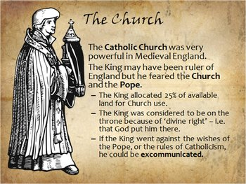
How religious were people in the Middle Ages?
Important words
Conquest | Take complete control over, usually a country
Pope | The head of the Catholic Church
Clergy | People who have jobs in the Church
Monk | A member of a religious community of men
Nun | A member of a religious community of women
Monastery | Where monks live and work. An abbot was the head of the monastery.
Nunnery | Where nuns live and work. An abbess was the head of the nunnery.
Pilgrim | A person who travels to a holy place for religious reasons
Pilgrimage | A journey of religious importance
Crusades | A series of journeys made by Christian Europeans to take the Holy Land back from Muslims in the Middle Ages; also known as the ‘Wars of the Cross’
Infidel | A person who has no religion or whose religion is not the same as that of another group of people
Important people
King William | William was keen to improve the Church in England. He introduced changes to the Church including making the rules stricter. He also appointed his own Archbishop of Canterbury, Lanfranc.
Pope Urban II | The Pope who called for Christians to fight wars against Muslims
Important ideas/information | Important ideas/information
1 | Roman Catholic | A follower of Roman Catholicism, which is now a group within a wider Christian Church. It was the only religion recognised in medieval Europe and specifically in Western Europe; Roman Catholics accept the Pope as their leader on Earth.
2 | Christian | A person who follows Christianity, a religion based on the life and teachings of Jesus Christ
3 | Christendom | Christian peoples or countries as a whole
Timeline
1066-1300 The number of monks quickly increased from 1,000 after William’s invasion. By 1300 there were over 12,000 in England. | 1096 – 1250 There were many Crusades to the Holy Lands | 1290 All Jews were expelled from England by Edward I

