Slide 1

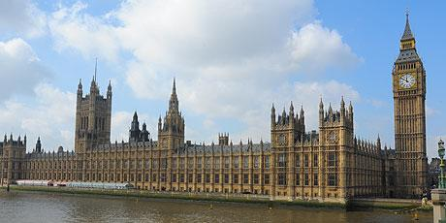
Medieval Events
Important words
Democracy | A system where people are able to decide how their country should be run
Freemen | Men who were freed from their feudal duties
Charter | A statement of a group of people’s rights and freedoms
Parliament | Controls the country and is made up of the Monarch, the House of Commons and House of Lords
Revolt | Another word for a rebellion or an uprising
Plague | An infectious disease that spreads quickly and kills a large number of people
Significance | Historical significance is about looking at the impact at the time (short term), its effects over a long period (long term), and whether it is still relevant today.
Important people
King John I | King of England, first monarch to sign the Magna Carta
Simon de Montfort | Leader of the barons, he led the army against King Henry in 1264
King Richard III | King of England, ruled during the Peasants’ Revolt
Wat Tyler | Leader of the Peasants’ Revolt
Important ideas/information
Magna Carta | King John ruled England at a difficult time. He faced wars with France, a shortage of money and clashes with powerful English barons. The barons became increasingly angry with John and eventually forced him to agree to changes in how England worked, written down in the Magna Carta. The Magna Carta is seen as the basis of many English laws and helped to influence the US constitution, which was written over 500 years later.
Black Death | In 1348 - 49, the Black Death swept across Europe, killing up to half of the population. There were two main types of plague: bubonic and pneumonic. Treatments and cures were based on both natural and supernatural theories about the cause of the disease.
Peasants Revolt | In 1381, peasants rebelled against King Richard II. The peasants were angry about a range of issues, such as low pay and the introduction of a poll tax. They demanded changes were made. The revolt did not achieve all of the peasants’ aims and the leader, Wat Tyler, was killed. In the longer term, there were some changes and improvements to peasants’ rights.
 | Timeline
June 1215 King John and the barons meet at Runnymede, King John agreed to a set of 63 promises (The Magna Carta) | 1347 The Black Death begins in Europe. This horrible disease would kill around half of the people in Europe. It arrived in England in 1348. | 30 May 1381 Peasants’ Revolt started when peasants in Essex refused to pay Poll tax

