Slide 1


Year 11 Key to Success evening
Today’s aim is to provide information to allow you to best support your child through their final GCSE year.

Slide 2
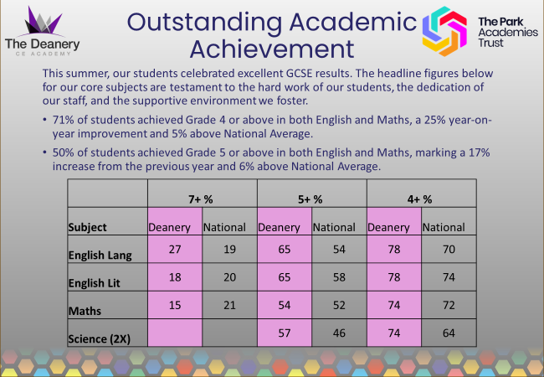

Slide 3
Important dates
Mock Examinations | 10th – 21st November
College Applications | December / January (check newsletter)
Subject Consultation Evening | 17th December
Mock Examinations | 2nd March – 12th March
GCSE Exam Session | 4th May – 26th June (NB Half Term)
Results Day | 20th August

Slide 4
Timeline
October
SLT Interviews
November 11th
Mocks (most subjects)
December 17th
Parent Consultation Evening
February
SLT Interviews
GCSE PE / Drama Practical
March 2nd
Mocks (most subjects incl MFL speaking)
Reports
Reports
May 4th - June 26th
Summer Exam Session
January
College Applications
College Applications
April
Speaking exams
Music Assessments
August 20th
Results Day

Slide 5
Core Subject Information
All students will sit examinations in Maths, English, Science and RE. They will also sit their relevant exams for options subjects.
Grade 4 is considered a 'standard pass' and grade 5 is considered a 'good pass’.
Students who fail to achieve a grade 4 in Maths and English will be required to resit the qualifications next year.
Make sure to check entry requirements for post 16 courses with providers.

Slide 6

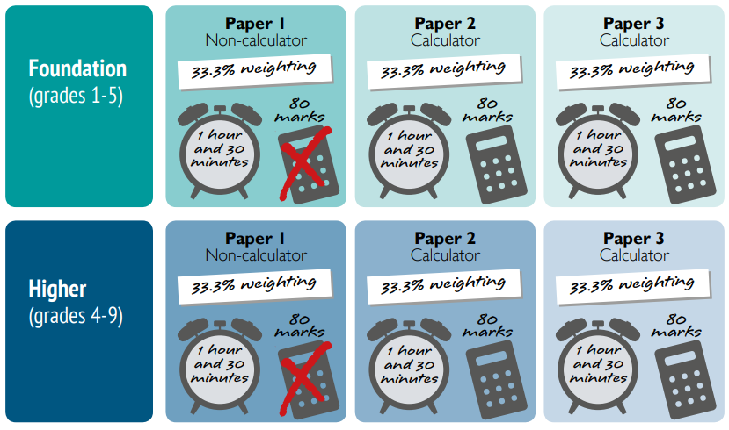
Core Subject Information - Maths
Grades 1-5
Grades 3-9

Slide 7
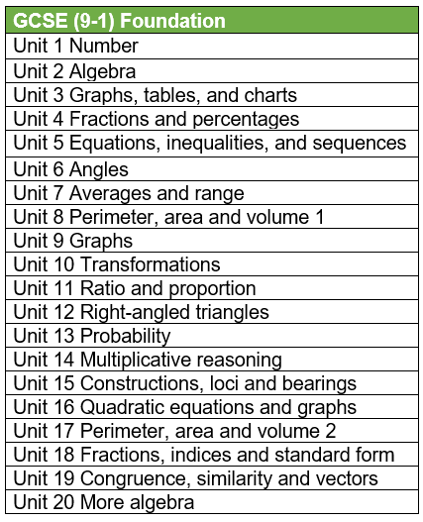
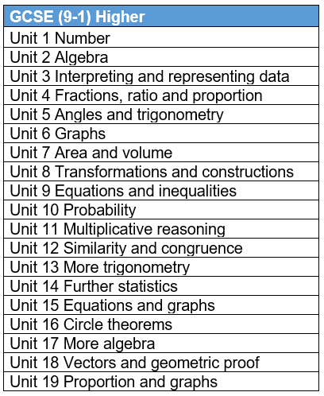
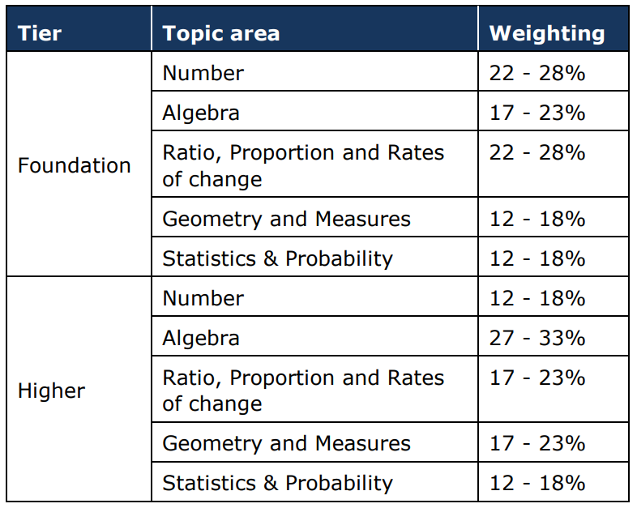
Core Subject Information - Maths

Slide 8
Core Subject Information - Maths
Examination code | Title | Date | Time | Duration
1MA1 1F | Paper 1 (Non-Calculator) Foundation Tier | Thursday 14th May | AM | 1h 30m
1MA1 1H | Paper 1 (Non-Calculator) Higher Tier | Thursday 14th May | AM | 1h 30m
1MA1 2F | Paper 2 (Calculator) Foundation Tier | Wednesday 3rd June | AM | 1h 30m
1MA1 2H | Paper 2 (Calculator) Higher Tier | Wednesday 3rd June | AM | 1h 30m
1MA1 3F | Paper 3 (Calculator) Foundation Tier | Wednesday 10th June | AM | 1h 30m
1MA1 3H | Paper 3 (Calculator) Higher Tier | Wednesday 10th June | AM | 1h 30m
FOUNDATION
Averages | 174 73% | 139 58% | 103 43% | 67 28% | 31 13%
3 papers totaling 240 marks (3 x 80 marks)
HIGHER
Averages | 200 83% | 169 70% | 139 58% | 108 45% | 77 32% | 46 19% | 31 13%

Slide 9
Revision – Independent Work at Home
Amazon Prices
Complete revision & practice £10
Targeted exam practice £5

Slide 10

Core Subject Information – Maths Homework
Weekly homework (Wednesday to Wednesday)
Personalised retrieval based on completion
All levels to challenge and support
Following the SOW taught in lesson
Scaffold videos to support each question

Slide 11

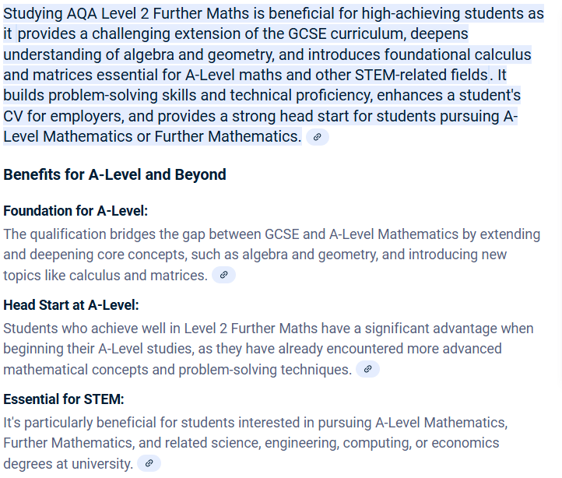
Enrichment – Further Maths GCSE
Tuesday 3:25-4:25pm
AQA Level 2 GCSE Maths
An extra GCSE
Available to pupils targeting a grade 7+
2025 Success for the first year!
3 x grade 9
2 x grade 8
1 x grade 6
5 x grade 5

Slide 12
Free Support – GCSE Maths
Mathsgenie
Corbettmaths
Sparx – independent learning

Slide 13
The Final Push – PGL Revision Weekend
Liddington, Swindon
Two night residential to PGL Liddington (in Swindon)
2 revision math's sessions taught, in correct tiers, by The Deanery math's staff (3 hours each day)
4 adventure activities with peers for a final secondary school residential (2 each day)
Full board (all meals included)
First come first serve for 30 students.
Dates and Cost TBC
Exam technique
Common misconceptions identified and corrected
Key topics revisit
Key skill retrieval

Slide 14


Core Subject Information – English
English Language
Paper 1: Fiction Reading & Writing (1hour 45 mins)
Paper 2: Non-Fiction Reading & Writing (1hour 45 mins)
Spoken Language: students are required to present a talk to their class (filmed and moderated by AQA)
English Literature
Paper 1: (‘old’ texts) 1 hour 45 mins
- Shakespeare’s ‘Macbeth’
- Charles Dickens’ ‘A Christmas Carol’
Paper 2: (modern texts) 2 hour 15 mins
- Priestley’s ‘An Inspector Calls’
- 15x Power & Conflict Poetry anthology poems
- 2x unseen poems to analyse & then compare
School-based revision resources:
DNA interleaved knowledge retrieval
Chanting quotations at end of lessons
Knowledge Organizers: key words, sentence stems & sentence starters, model examples (Standard vs. Excellent), essay structures/writing frames/structure strips
Enrichment GCSE Literature Revision 3:30-4:30pm Thursdays in 1-02 with Mrs. Mills
Enrichment GCSE Language Past Paper Club (Begins in January)
Tutor Time Intervention- students identified through mock data
Resources to use at home
English section of school website: Knowledge Organisers, key quotations to learn, past papers, links to external revision websites https://www.dcea.org.uk/parent-information/our-curriculum/subjects/english/
Tassomai online homework platform 45mins weekly
Tuesday Test Day (pink homework book)
Please encourage your child to read at home- worth 50% of GCSE Language and is THE most important thing your child can do to prepare for GCSE English Language

Slide 15

Tuesday Test Day in pink homework books
In Year 11, pupils are given an extra exercise book (yellow- classwork; pink- homework)
Pink book homework is fortnightly
Students are given a good model essay to read and annotate, alongside a new exam question to prepare an essay plan for
Students will have a week to prepare for this test (e.g. gathering contextual info, quotations, and writing an essay plan, etc.) at home. They should make their plan in their Pink homework book
On Tuesday Week 1, pupils will need to bring their Pink homework book to school to write up their ‘Test’ (essay) in school
Essays will be ranked and students will receive feedback & improvement tasks on their essay the following lesson
As the year progresses, and as students become more confident with this process, we remove some of the scaffolds (e.g. the model essay) that is in place- so that students are gaining necessary independent revision skills.

Slide 16

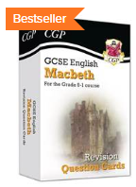
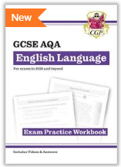
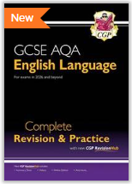
Core Subject Information – English
What can you do to help?
Ask them about the pink book essay that they're currently planning
Get them to dig out their Yr10 exercise book and booklets
Remind them about our weekly Thursday revision opportunity
Test them using their flashcards
Encourage them to continue reading
Talk to them about current affairs/topical issues
Talk to us
Please encourage your child to read at home- worth 50% of GCSE Language and is THE most important thing your child can do to prepare for GCSE English Language

Slide 17

Core Subject Information : Science
2 Routes – No Decision until Year 11 Mocks
Key Facts
Qualification Name: GCSE Combined Science - Trilogy
Assessment: 100% Examination
Examination Board: AQA
12th May
To
15th June
2026
Key Facts
Qualification Name: GCSE Biology, Chemistry & Physics
Assessment: 100% Examination
Examination Board: AQA

Slide 18
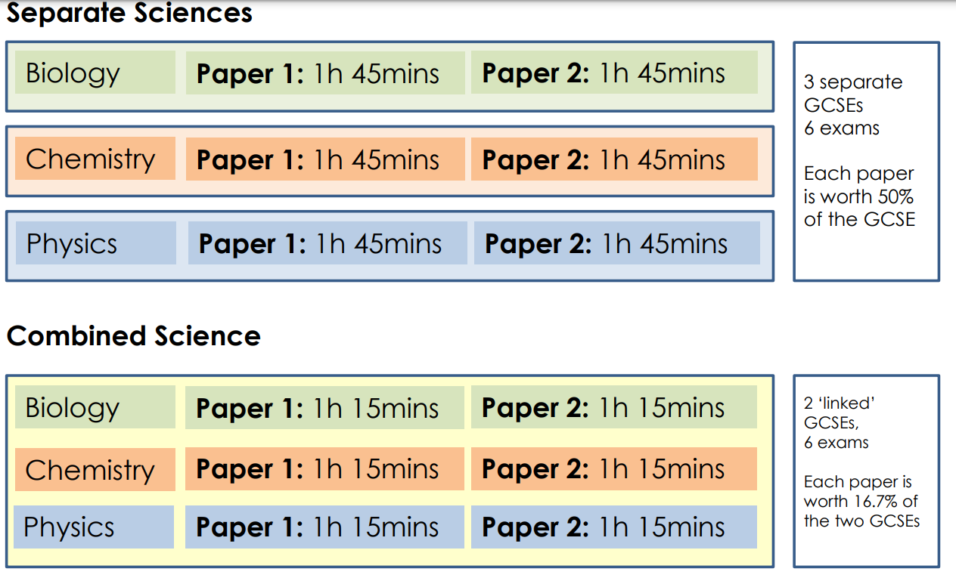
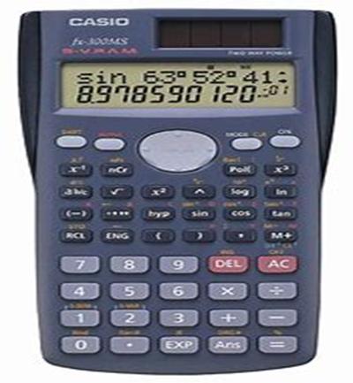
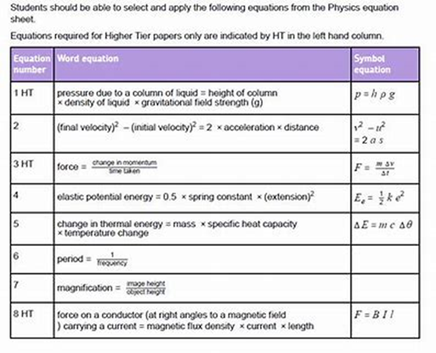
Exam Information

Slide 19
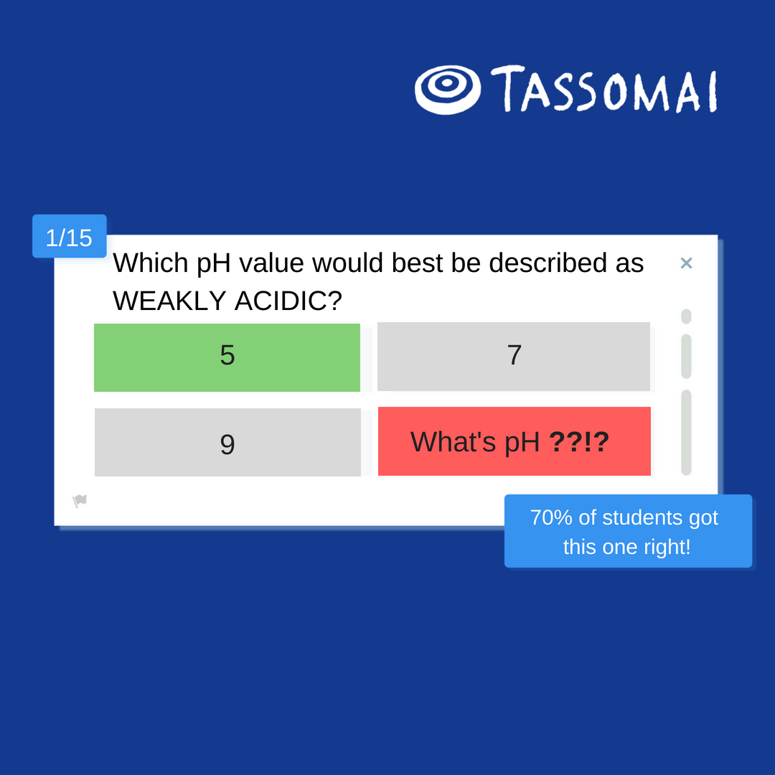
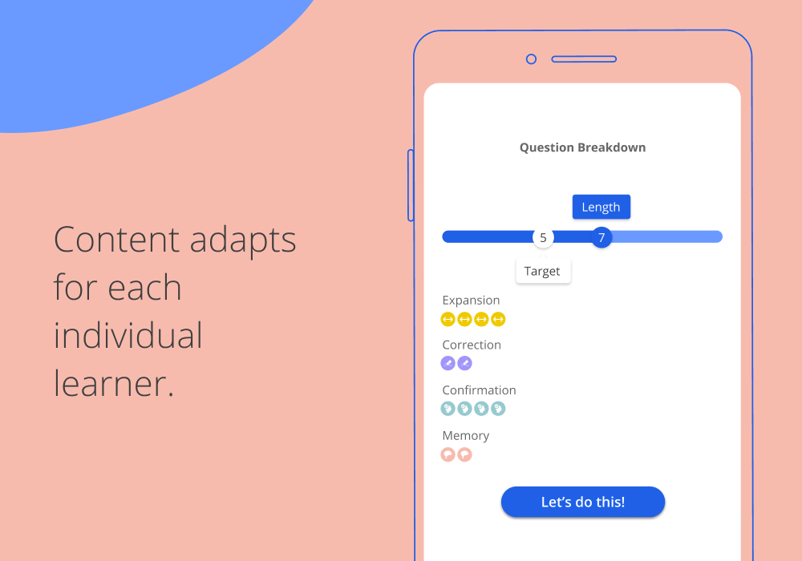
Science Homework Platform: Tassomai
Students learn through quizzes and short videos, using our mobile app or other online devices.

Slide 20
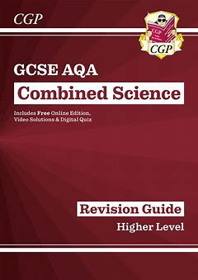
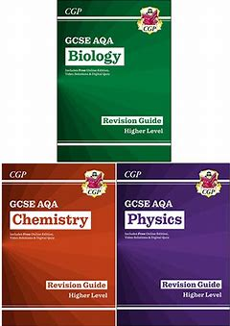


Science Revision
Wednesday 3.30 to 4.30pm
See Mrs Hockin tonight

Slide 21

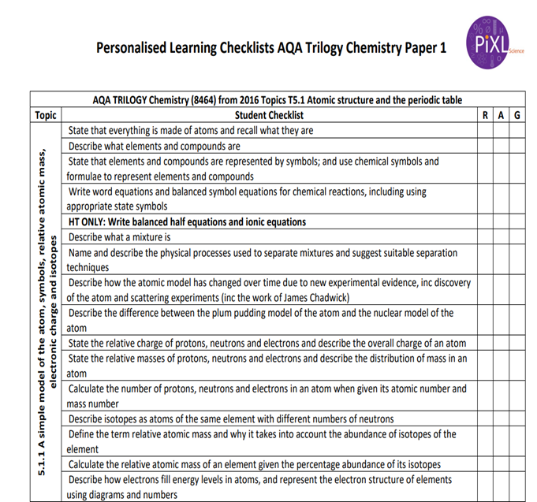
SUCCESS in SCIENCE
● Skills for managing stress
● Exam preparation technique/support – use Tassomai/Retrieval Grids
● Recognising your areas of strength and weakness in Biology, Chemistry and Physics
Revision | Details | What to bring?
Science Revision Café Wednesday 3.30 – 4.30pm | Drop-in Science support session that runs throughout the year | Pen and Paper Revision Guide Questions
Focused Science Intervention Terms 1 to 5 12.20 – 12.50pm | Structured questions/walking talking mock style revision sessions that cover key areas of the specification | Pen and Paper Revision Guide Questions

Slide 22

Why do we all have to study GCSE RS?
As a Church of England school we believe an excellent RS education is invaluable to becoming a tolerant and compassionate society
Throughout our lives, we are going to meet lots of different and diverse people
By studying RE, we are learning more about the world around us and showing that we care about the society we live in
Our 5 British values are what we as a society believe are important, and one of these is ‘tolerance of different faiths and beliefs’
By learning about other faiths and beliefs, we become a much more respectful and compassionate society

Slide 23


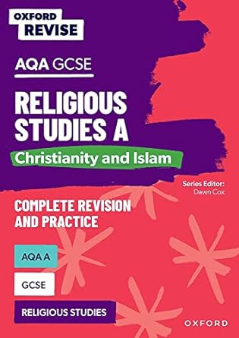

Core Subject Information: Religious Studies A
Paper 1 = study of two religions: Christianity & Islam (1hr 45 mins exam )
Paper 2 = Study of 4 themes:
Religion & life
Religion, peace & conflict
Religion, crime & punishment
Religion, human rights & social justice
(1hr 45 mins exam )
GCSE RS revision
From January 2026 on a Thursday at 3:30
Top tips for success in RS:
Practice timings! Work to approximately a mark per minute
Learn key quotes The strongest arguments have evidence to support them
Ensure you know divergent views within religions e.g. Sunni and Shi'a; Catholic and Anglican
In an RS exam, you MUST refer to religion! 12-mark questions are capped at 6 marks if you do not reference religion
Attempt all the questions, even if you are unsure
Revise the topics you find the most difficult
Do not leave revision to the last minute! Use your teachers knowledge to help you throughout the year
OUP have recently produced a new revision guide for the GCSE RS course.
If you would like to order one, please do so via your ParentPay account by November 30th and we will order them in bulk, at a discounted price of £5.50
For further information, please contact Mrs Sarah Gallagher at:
Gallaghers@deanerycofeacademy.org.uk

Slide 24



Useful RE revision aids
Seneca – A free revision app for students, where they can revise individual topics for specific exam boards.
BBC Bitesize - Free
Revision world - Free

Slide 25
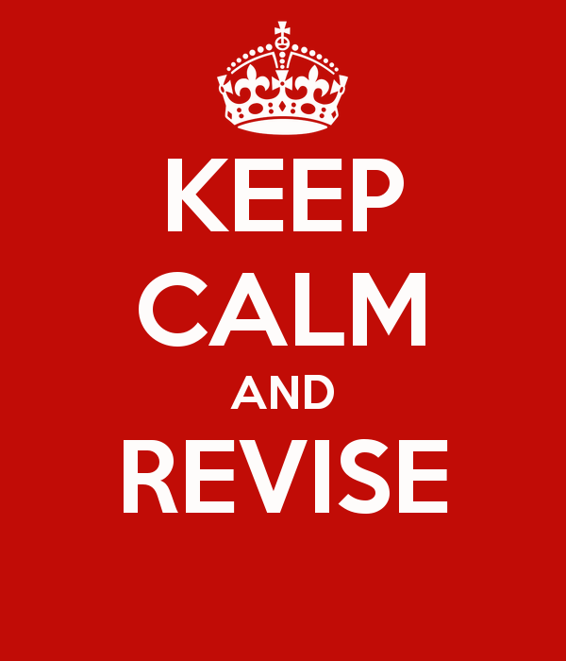
What can I do to help my child at home?
If possible, provide a calm, quiet area that is free from distractions.
Help them plan an allocated time to revise – including breaks.
Praise them.
Encourage them.
Take an interest (not an over interest) in what they are doing.
Maybe ask if they want you to quiz them or even revise with them.
Provide revision resources such as revision guides or printed past papers (school can help).
Support them doing what they enjoy in parallel to revision such as clubs and activities.
Ensure stable routines: meal-times and bed-times.

Slide 26
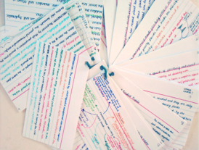
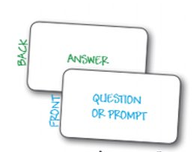
Revision Techniques
AO1 – Knowledge recall
1. Creating or using flash-cards
2. Reading knowledge organisers and re-creating them from memory
3. Watching You-Tube clips and making notes
4. Testing yourself with multiple choice quizzes
5. Reading revision guides or textbooks and making notes

Slide 27
Revision Techniques
AO2 – Applying knowledge
1. Try summary questions in revision guides or textbooks
2. Practice some past exam questions and check these with the mark scheme.
3. Try some online quizzes.
4. Ask friends and family to question you on a particular topic using key command works from the exam “describe or explain”.
5. Ask your teacher for subject specific advice.

Slide 28
Revision Techniques
AO3 – Linking your knowledge
1. Try whole past exam papers.
2. Read model examples and check them against your own attempt
3. Use the mark scheme to mark your own paper.
4. Read the mark-scheme and annotate both the past paper and the mark-scheme.
5. Ask your teacher for a past paper question to take home, bring it to them and ask them to go over it with you.

Slide 29
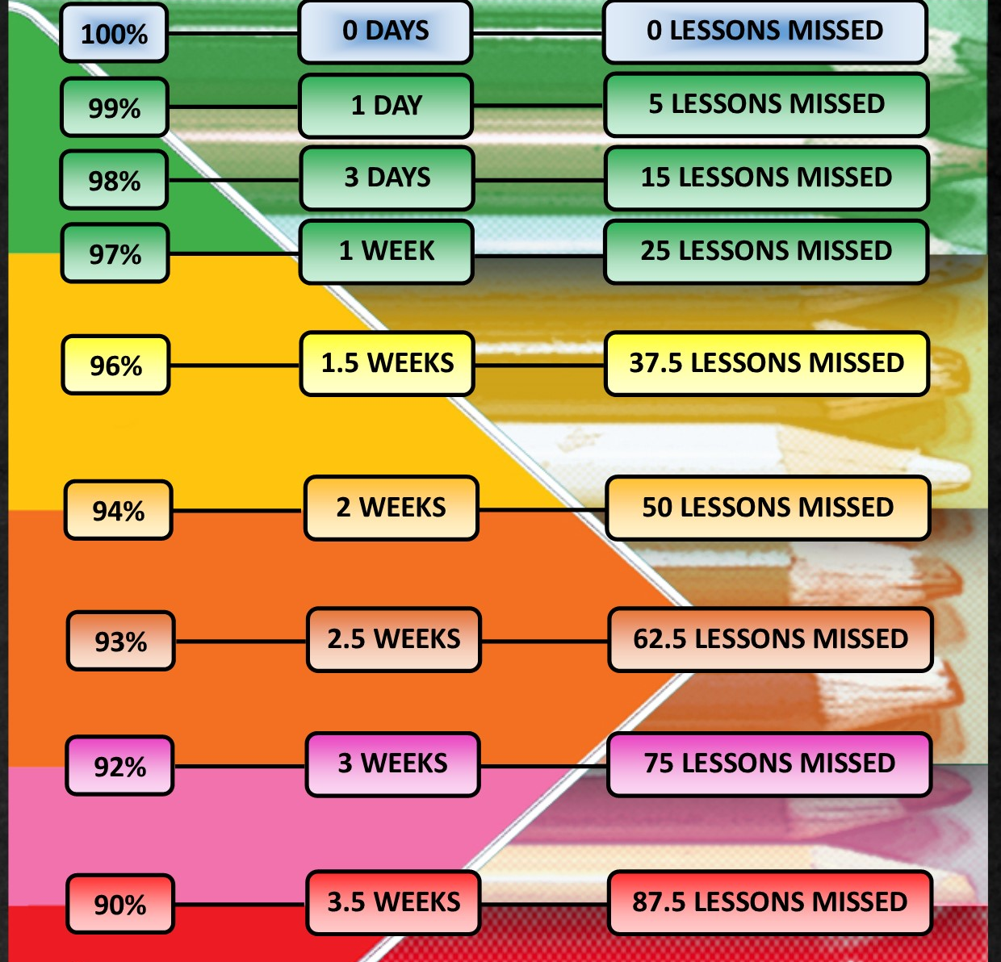
Attendance Matters
Maximise your potential,
attend school every day.
Attendance >95%
On average half a grade better in every subject.
Attendance <90%
On average one a half grades worse in every subject.

Slide 30
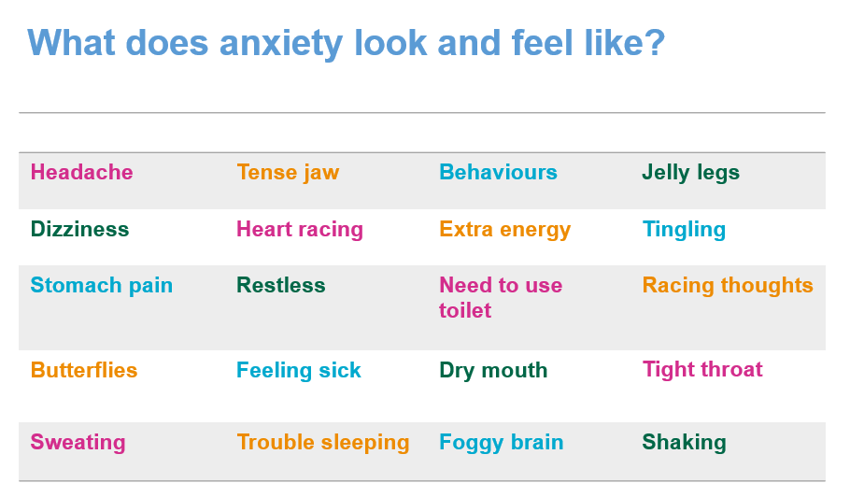
Exam Stress Management
It's OK to feel anxious – it can be a good thing!
Anxiety isn't necessarily a bad thing. It can spur us on, help us stay alert, make us aware of risks and motivate us to solve problems.

Slide 31
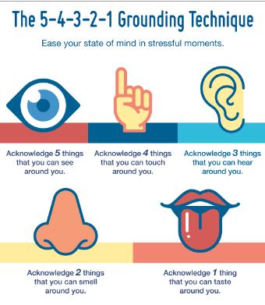
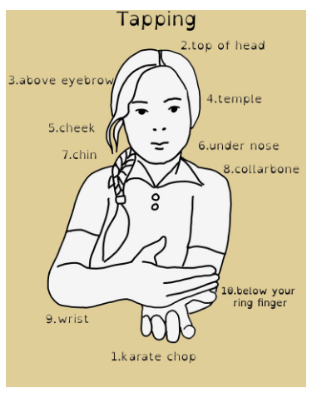
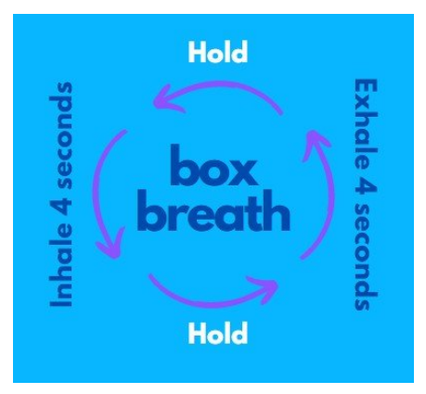

General stress management tips
Be prepared! A lot of the anxiety can be prevented with good preparation – early revision, looking at past papers, schoolwork etc.
Exercise
Eating healthily
Sleep
Limit time of social media/electronics.

Slide 32
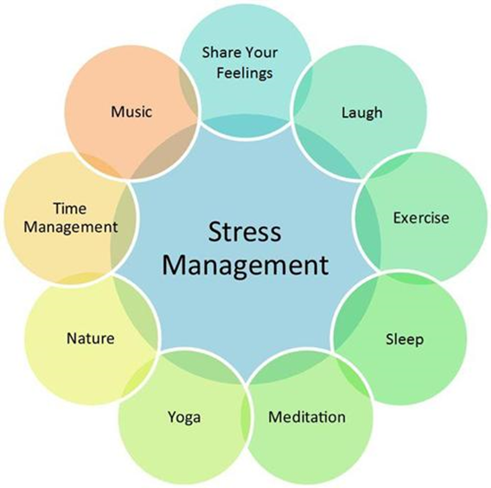
What are we doing in school?
Tutor program now includes revision skills and exam stress management on a weekly basis
More focus on exam techniques in lessons to support students feel prepared.
Careers guidance in school to help with important decisions.
BRIYM counselling – 1:1 but also will be visiting tutor groups to offer support.
https://www.briym.co.uk/parents

Slide 33
Students, when you need support …
Feeling nervous or worried are normal emotions:​
​
Communicate with parents and teachers​
Tutor – Exam preparation and skills time ​
Head of Year – Ms Penny-Larter​
Assistant Head of Year – Ms Byrne​
KS4 Raising Standards Lead – Mrs Scotford
SENco – Dr Kafka Markey ​- for any Access Arrangement information kafka-markeyc@deanerycofeacademy.org.uk
Teaching Assistants ​
Post 16 and Careers

Slide 34
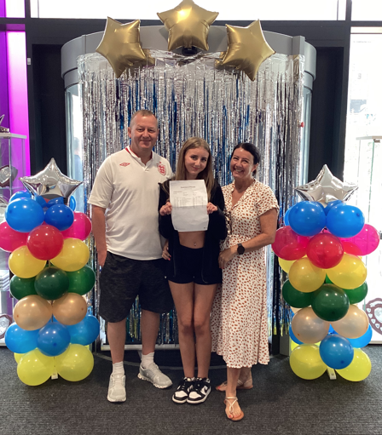
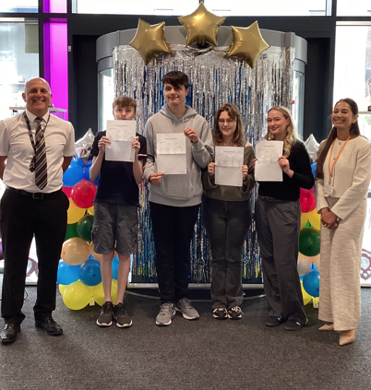
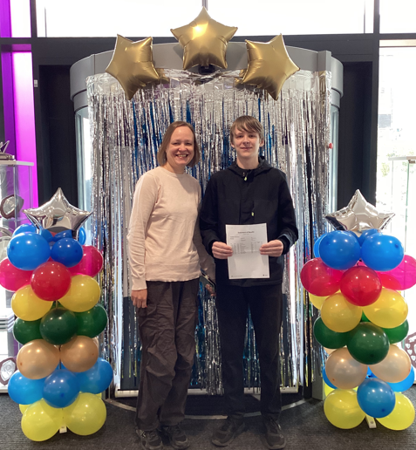
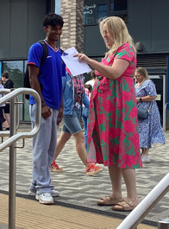
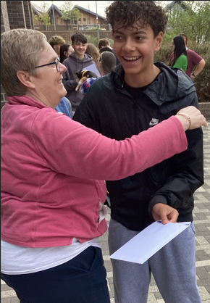
Thursday 20th August 2026
We will see success together!
There is a booklet to take with you covering all the information given this evening. Information will also be shared on the school website.

