Slide 1


Year 10 Key to Success evening
Today’s aim is to provide information to allow you to best support your child through their GCSE years.

Slide 2
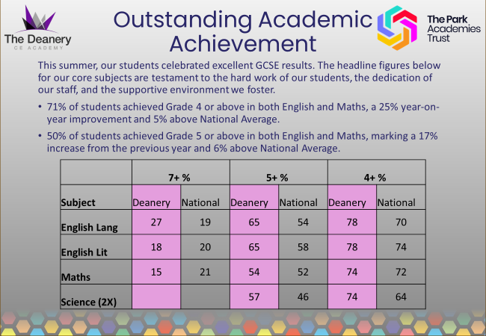

Slide 3
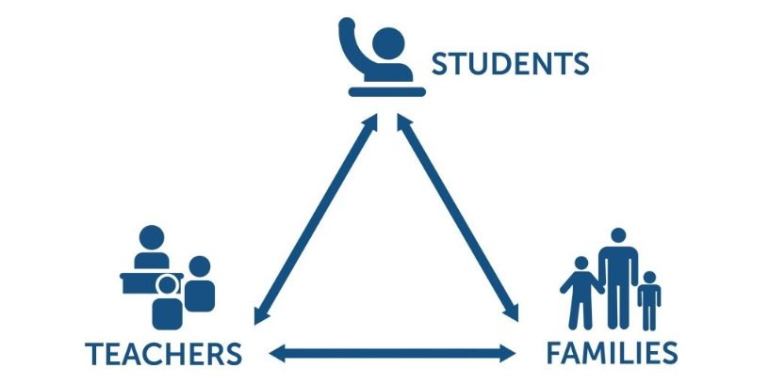
KS4 – prepare for a Three Way Effort ​ ​ ​ ​ ​
Departing Year 11 pupils within the TPAT schools rated support from home the top factor in their success at KS4

Slide 4
KS4 – Curriculum Time
 | Key Stage 4 - Hours per fortnight.
 | Year 10
English | 8
Maths | 7
Science | 10
RE | 4
PE | 3
ViP | 1
Option 1 | 5
Option 2 | 5
Option 3 | 5
Homework
Most GCSE subjects will set homework on a weekly or fortnightly basis. Students should be prepared to complete two hours of homework a night at KS4.

Slide 5
Subject Information
All students will sit examinations in Maths, English, Science and RE. They will also sit all their relevant exams for options subjects.
Grade 4 is considered a 'standard pass' and grade 5 is considered a 'good pass’.
Students who fail to achieve a grade 4 in Maths and English will be required to resit the qualifications next year.
Make sure to check entry requirements for post 16 courses with providers.
Students will not be able to switch GCSE option subjects.
The English Baccalaureate is awarded to students achieving a Standard or Good pass in English, Maths, Science, Languages and a Humanities subject.

Slide 6
KS4 – Examination Boards
Maths - Edexcel
English - AQA
Science - AQA
Religious Studies - AQA
History - Edexcel
Geography - AQA
Drama – OCR
French - AQA
Hospitality & Catering - WJEC
Fine Art - AQA
Photography - AQA
Textiles - AQA
Health & Social Care – Pearson BTEC
PE – OCR
Sports Studies – OCR
Music – Eduqas
Computing - Edexcel

Slide 7
Important dates
September 2025 | Begin new Key Stage option subjects
December 2025 | Reports Home – target grades
3rd December 2025 | Subject Consultation Evening
March 2025 | Reports Home
June / July | Mock Exam session (most exams) Reports Home

Slide 8

Core Subject Information - Maths

Slide 9
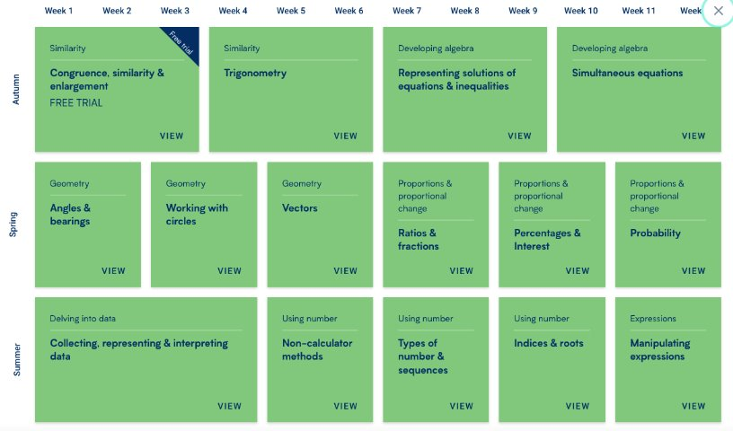

Core Subject Information - Maths

Slide 10
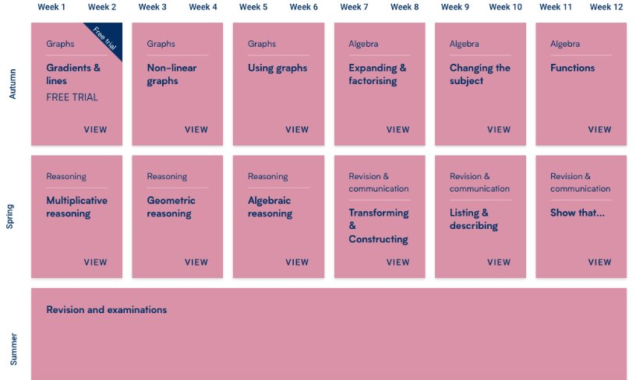
Core Subject Information - Maths

Slide 11
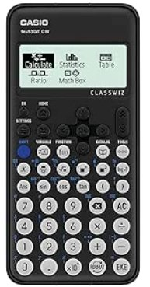
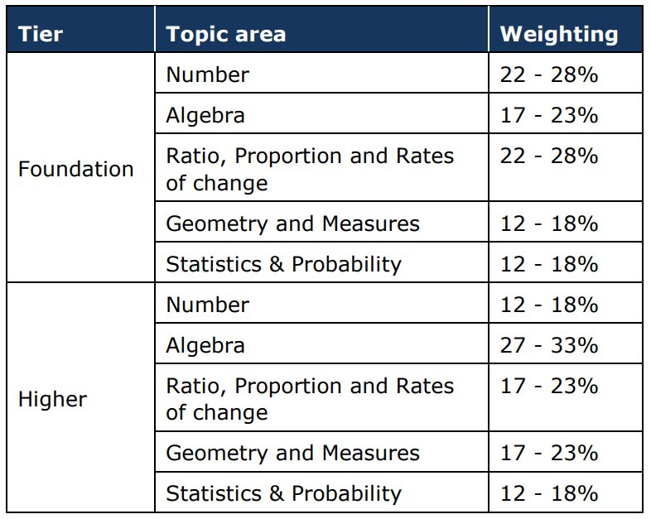

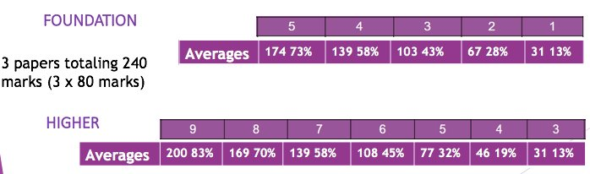
Core Subject Information - Maths
Based on 2025 results, subject to change slightly (% went up by approx 1% from 2024)

Slide 12

Core Subject Information - Maths
Weekly homework (Wednesday to Wednesday)
Personalised retrieval based on completion
All levels to challenge and support
Following the SOW taught in lesson
Scaffold videos to support each question

Slide 13
Core Subject Information - Maths
Revision – Independent Work at Home
Amazon Prices
Complete revision & practice £10
Targeted exam practice £5
Getting prepared early.

Slide 14

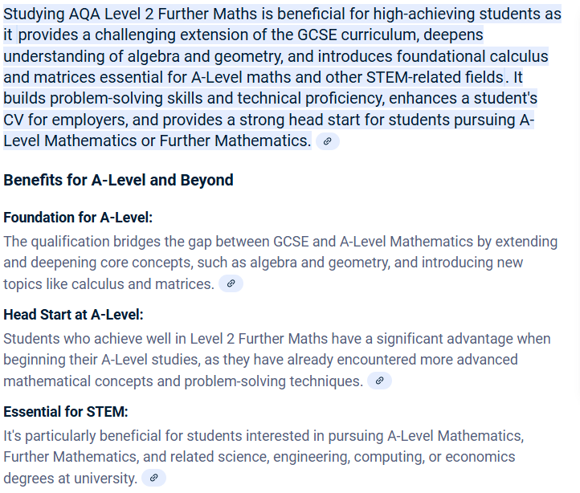
Enrichment – Further Maths GCSE
AQA Level 2 GCSE Maths
An extra GCSE
Available to pupils targeting a grade 7+
Starts in July for year 10 by invite
2025 Success for the first year!
3 x grade 9
2 x grade 8
1 x grade 6
5 x grade 5

Slide 15
Year 10 Maths – Tips and Advice
Get organised early! Ask the questions and make revision cards from now!
Year 10 and year 11 are schemes that follow on, retrieval is key the teaching may not be seen again!
Take mocks and unit assessments seriously
Ask for how to improve on assessments
Experiment with revision techniques (be ready for year 11)
To learn and revise maths, is to do maths!
Enjoy the subject, when you enjoy your lesson and learning, you have better outcomes and higher confidence.
Support from parents – academic and mindset

Slide 16


Core Subject Information – English
English Language
Paper 1: Reading & Writing (1hour 45 mins)
Paper 2: Reading & Writing (1hour 45 mins)
Spoken Language: students required to present a talk to their class (filmed and moderated by AQA)
English Literature
Paper 1: (‘old’ texts) 1 hour 45 mins
- Shakespeare’s ‘Macbeth’
- Charles Dickens’ ‘A Christmas Carol’
Paper 2: (modern texts) 2 hour 15 mins
- J.B.Priestley’s ‘An Inspector Calls’
- 15x Power & Conflict Poetry anthology poems
2x unseen poems to analyse & then compare
Resources to use at home
English section of school website: Knowledge Organisers, key quotations to learn, past papers, links to external revision websites https://www.dcea.org.uk/parent-information/our-curriculum/subjects/english/
Tassomai online homework – 45mins of weekly quizzing
School-based revision resources:
DNA interleaved knowledge retrieval
Chanting/reciting quotations at end of lessons
Knowledge Organizers: key words, sentence stems & sentence starters, model examples (Standard vs. Excellent), essay structures/writing frames/structure strips
Please encourage your child to read at home- worth 50% of GCSE Language and is THE most important thing your child can do in year 10 to prepare for GCSEs

Slide 17

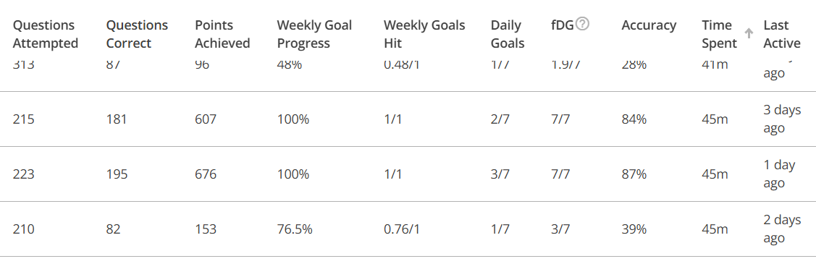
Core Subject Information – Yr10 English
Term 1 = Macbeth
Term 2 = A Christmas Carol
Term 3 = Language Paper 1: Reading
Term 4 = Language Paper 1: Writing
Term 5 = An Inspector Calls
Term 6 = Revision/Mock exams/Spoken Word presentations

Slide 18

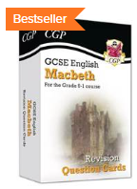
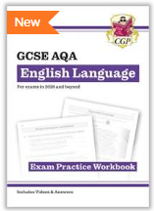

Core Subject Information – English
What can you do to help?
Ask them about the text they're currently studying
Remind them about our weekly Tassomai homework
Test them using their flashcards
Purchase revision guides/workbooks for them to use
Encourage them to continue reading
Talk to them about current affairs/topical issues
Talk to us
Please encourage your child to read at home- worth 50% of GCSE Language and is THE most important thing your child can do to prepare for GCSE English Language

Slide 19

Core Subject Information : Science
2 Routes – No Decision until Year 11
Key Facts
Qualification Name: GCSE Combined Science - Trilogy
Assessment: 100% Examination
Examination Board: AQA
Key Facts
Qualification Name: GCSE Biology, Chemistry & Physics
Assessment: 100% Examination
Examination Board: AQA

Slide 20
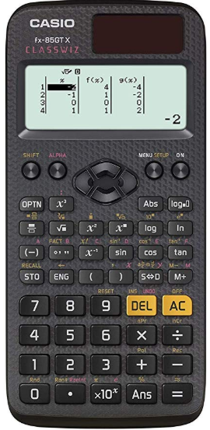
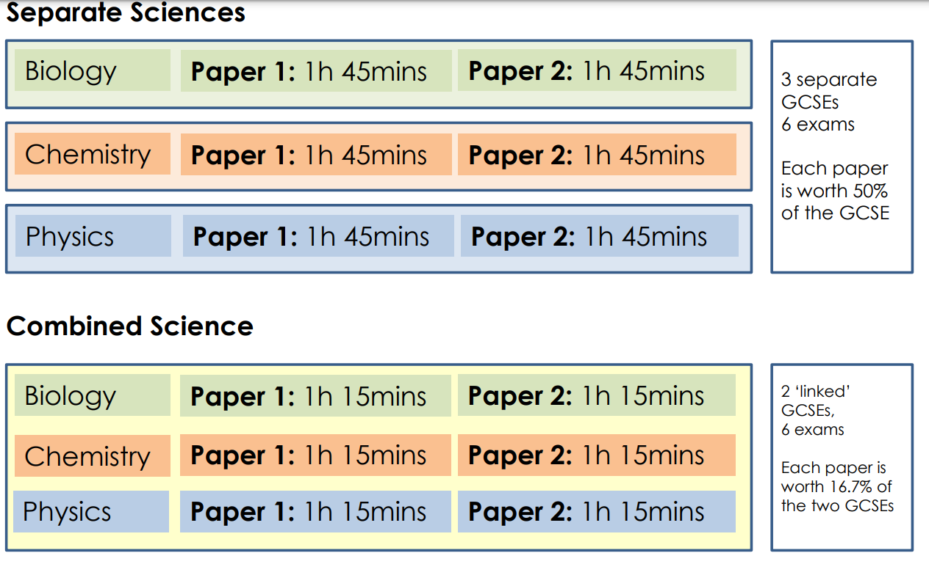
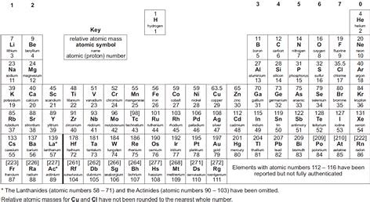
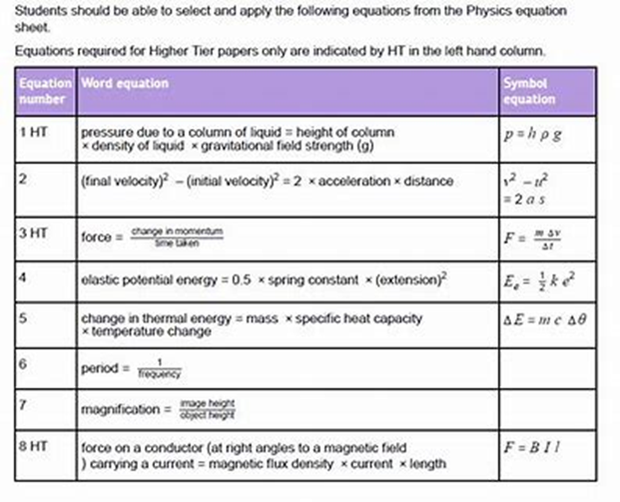
Science Exam Information

Slide 21
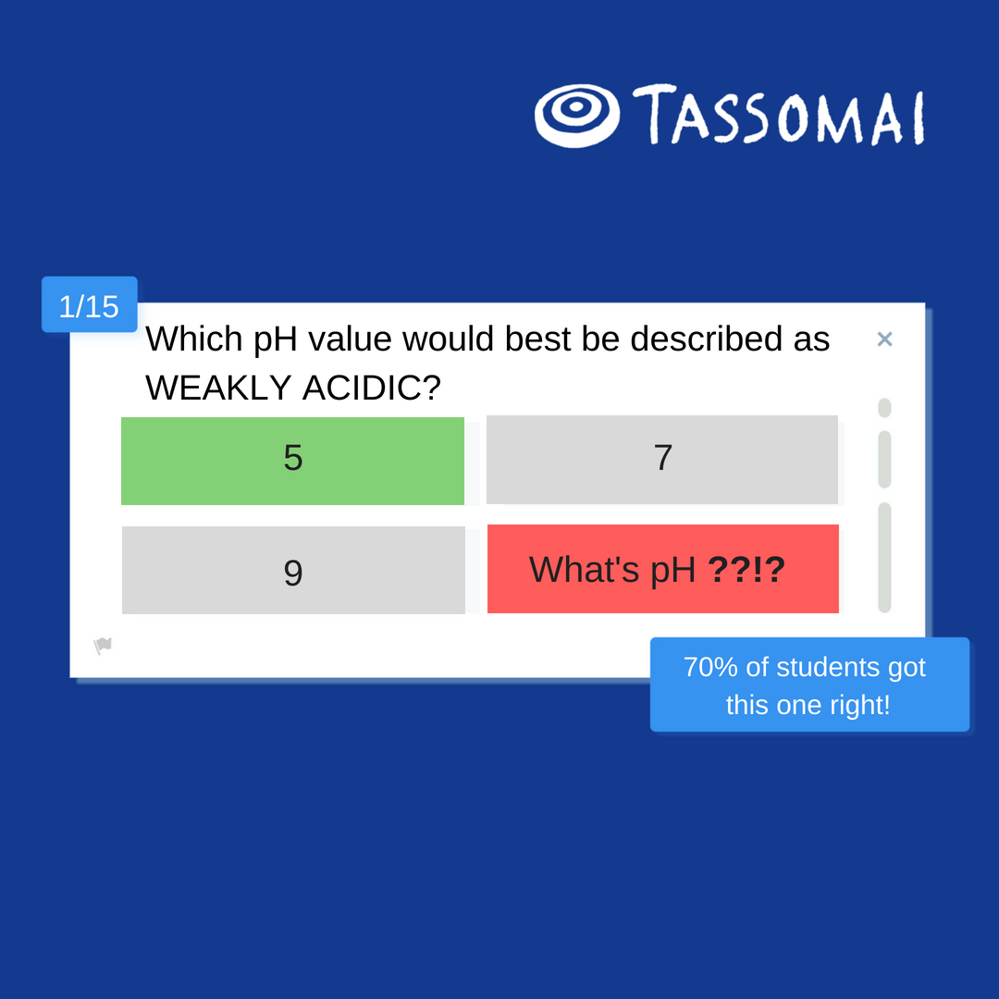
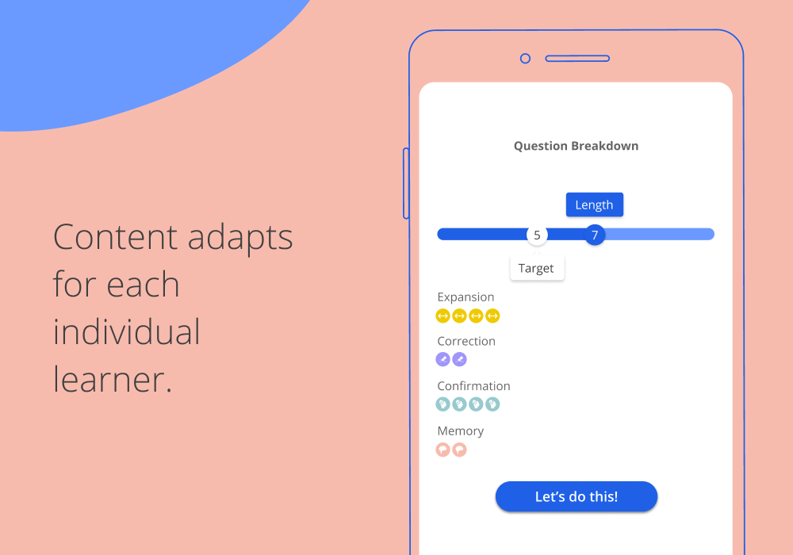
Homework Platform: Tassomai
Students learn through quizzes and short videos, using our mobile app or other online devices.

Slide 22
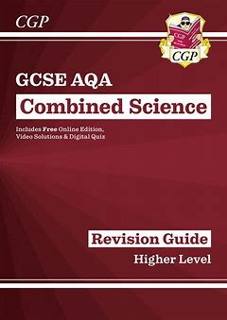
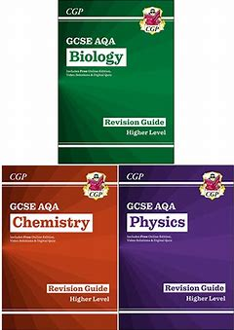


Science Revision
Revision Letter

Slide 23
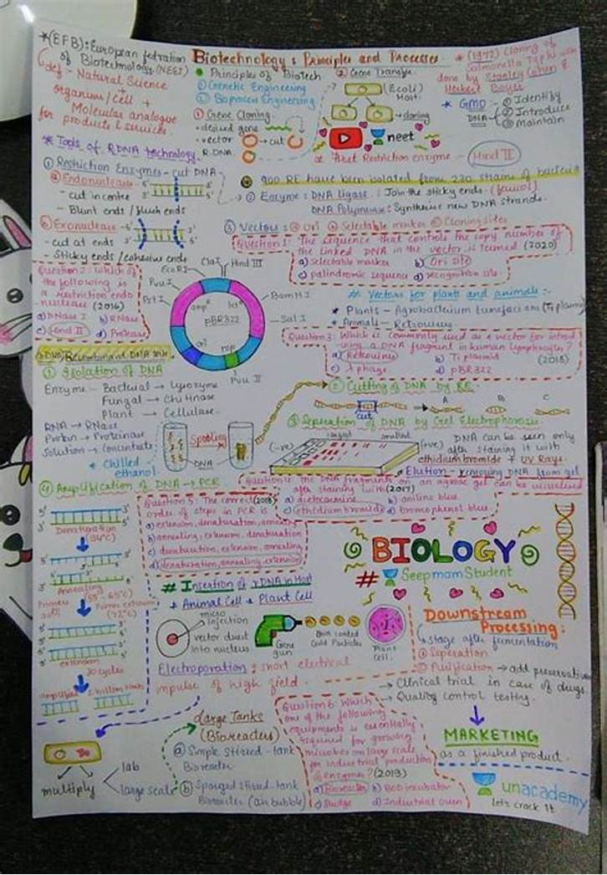
Success in Science
Science Priorities for this Term
● Settling in – 3 Science Teachers
● Building relationships with teachers
● Consistency
Term 2 to 6
● Structured questions/walking talking mock style revision sessions that cover key areas of the specification
● Use of Revision Guide
● Use of Revision Resources

Slide 24

Why do we all have to study GCSE RS?
As a Church of England school we believe a good RE education is invaluable to becoming a tolerant and compassionate society
Throughout our lives, we are going to meet lots of different and diverse people
By studying RE, we are learning more about the world around us and showing that we care about the society we live in
Our 5 British values are what we as a society believe are important, and one of these is ‘tolerance of different faiths and beliefs’
By learning about other faiths and beliefs, we become a much more respectful and compassionate society

Slide 25


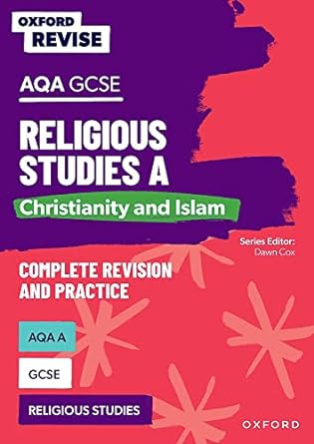

Core Subject Information: Religious Studies A
Paper 1 = study of two religions: Christianity & Islam (1hr 45 mins exam – AM 13th May 2025)
Paper 2 = Study of 4 themes:
Religion & life
Religion, peace & conflict
Religion, crime & punishment
Religion, human rights & social justice
(1hr 45 mins exam – PM 21st May 2025)
GCSE RS revision
From January 2025 on a Thursday at 3:30
OUP have recently produced a new revision guide for the GCSE RS course.
If you would like to order one, please do so via your ParentPay account by November 30th and we will order them in bulk, at a discounted price of £5.50
Top tips for success in RS:
Practice timings! Work to approximately a mark per minute
Learn key quotes The strongest arguments have evidence to support them
Ensure you know divergent views within religions e.g. Sunni and Shi'a; Catholic and Anglican
In an RS exam, you MUST refer to religion! 12-mark questions are capped at 6 marks if you do not reference religion
Attempt all the questions, even if you are unsure
Revise the topics you find the most difficult
Do not leave revision to the last minute! Use your teachers knowledge to help you throughout the year
For further information, please contact Mrs Sarah Gallagher at:
Gallaghers@deanerycofeacademy.org.uk

Slide 26



Useful RE revision aids
Seneca – A free revision app for students, where they can revise individual topics for specific exam boards.
BBC Bitesize - Free
Revision world - Free

Slide 27

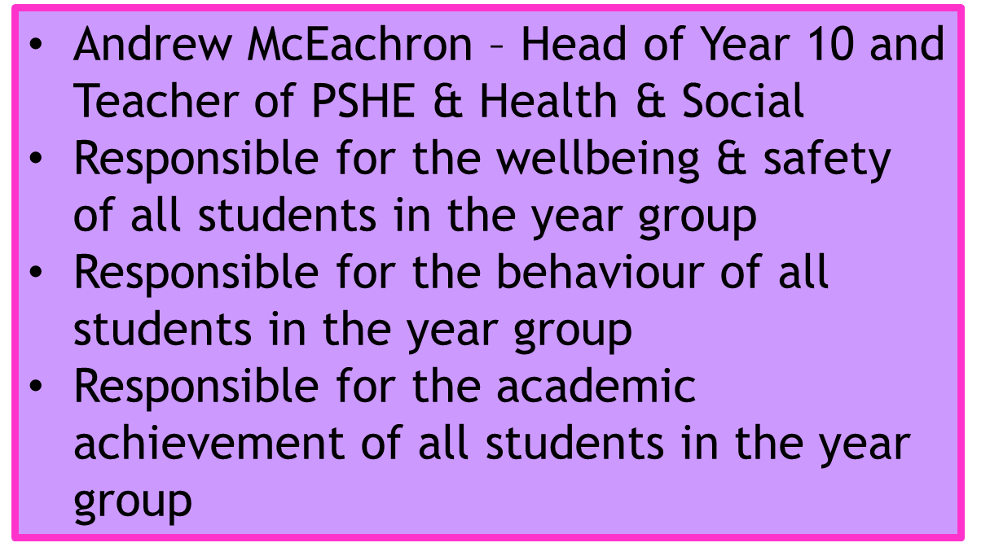

Head Of Year – Welcome

Slide 28
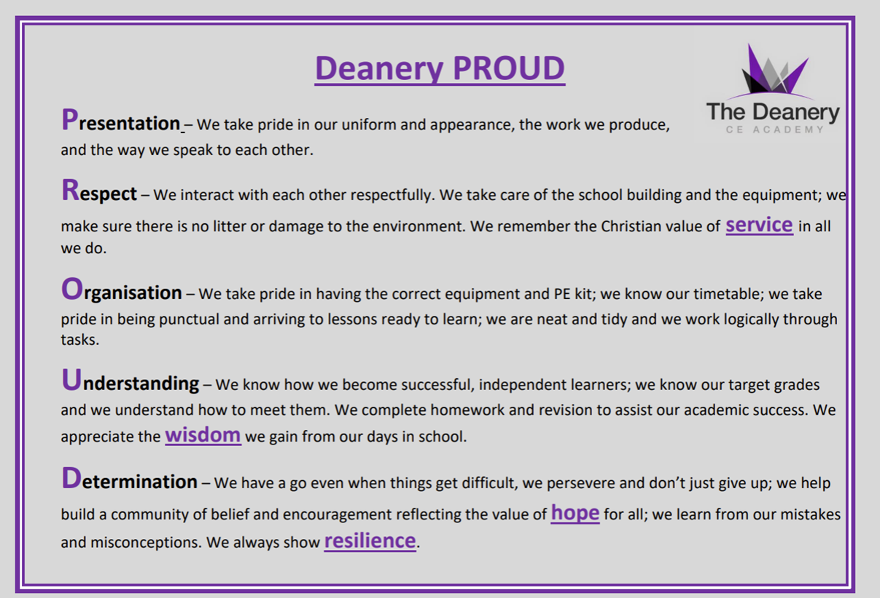
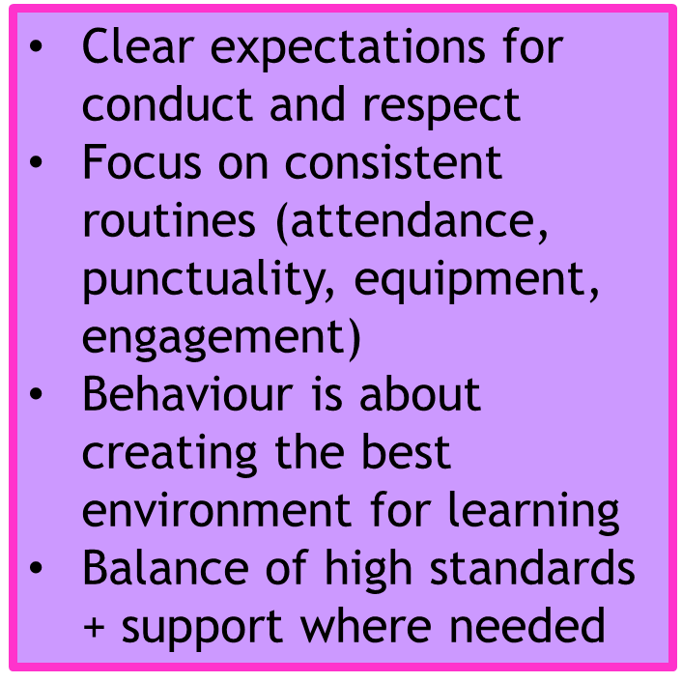
Behaviour for Learning

Slide 29
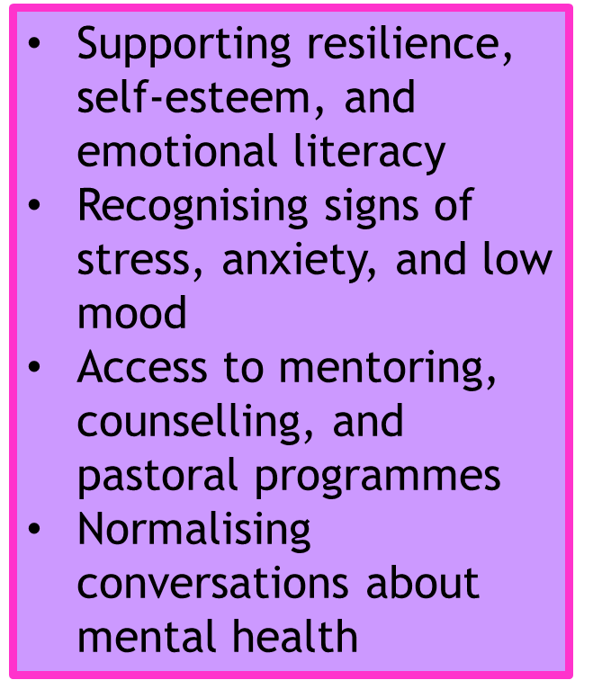

Focus on Mental Health & Wellbeing

Slide 30








Slide 31
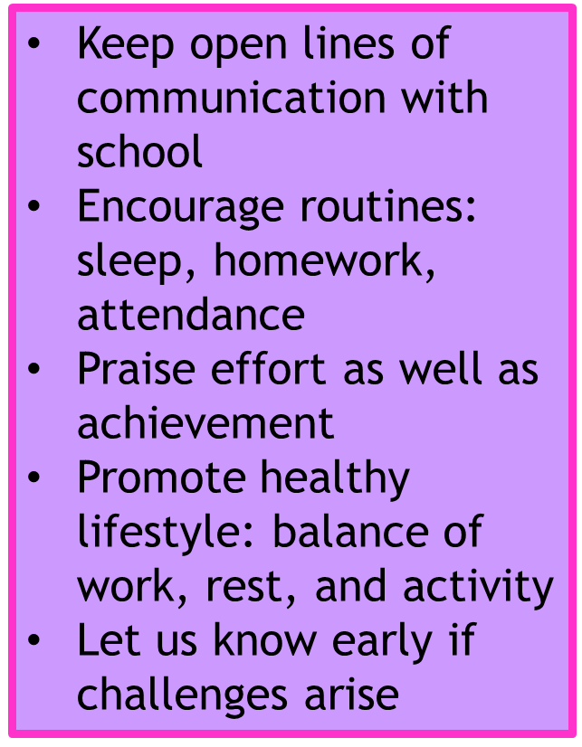

How Parents Can Help

Slide 32
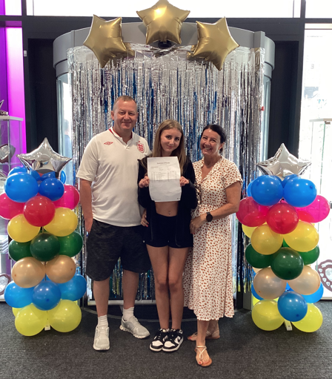
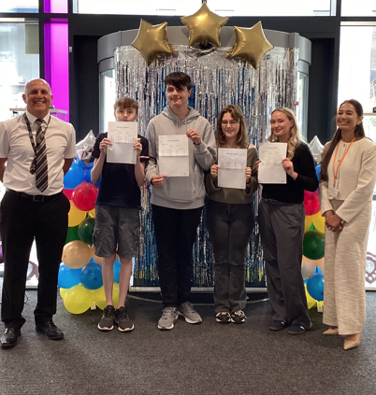
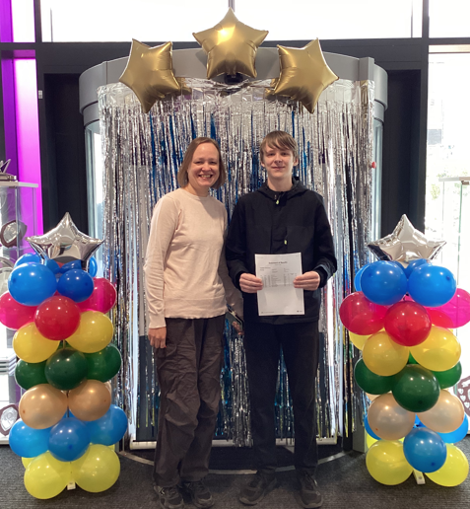
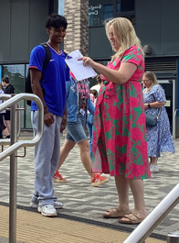
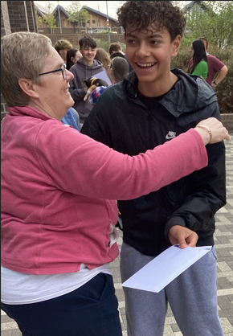
August 2027
We will see success together!
There is a booklet to take with you covering all the information given this evening. Information will also be shared on the school website.

